Slide 1

By
Dr. A. GEETHA
Final year cse – a batch
ETHS701 ENGINEERING ETHICS
Annamalai University
DEPARTMENT OF COMPUTER SCIENCE AND ENGINEERING
ANNAMALAI NAGAR-608 002

Slide 2
ETHS701 ENGINEERING ETHICS
Course Objectives:
• To provide basic knowledge about engineering Ethics, Variety of moral issues and Moral dilemmas, Professional Ideals and Virtues.
• To familiarize about Engineers as responsible Experimenters, Research Ethics, Codes of Ethics, Industrial Standards,
• To educate the Safety and Risk, Risk Benefit Analysis.
• To teach about the Collegiality and Loyalty, Collective Bargaining, Confidentiality, Occupational Crime, Professional, Employee, Intellectual Property Rights.
• To impart knowledge about MNC’s, Business, Environmental, Computer Ethics, Honesty, Moral Leadership, sample Code of Conduct.

Slide 3
ETHS701 ENGINEERING ETHICS
UNIT-I Introduction
Senses of ‘Engineering Ethics’ – Variety of moral issues – Types of inquiry – Moral dilemmas – Moral Autonomy – Kohlberg’s theory – Gilligan’s theory – Consensus and Controversy – Professions and Professionalism – Professional Ideals and Virtues – Uses of Ethical Theories.
UNIT-II Challenges
Engineering as Experimentation – Engineers as responsible Experimenters – Research Ethics - Codes of Ethics – Industrial Standards - A Balanced Outlook on Law – The Challenger Case Study.
UNIT – III Risk Analysis
Safety and Risk – Assessment of Safety and Risk – Risk Benefit Analysis – Reducing Risk – The Government Regulator’s Approach to Risk - Chernobyl Case Studies and Bhopal.
UNIT – IV Loyalty
Collegiality and Loyalty – Respect for Authority – Collective Bargaining – Confidentiality – Conflicts of Interest – Occupational Crime – Professional Rights – Employee Rights – Intellectual Property Rights (IPR) – Discrimination.
UNIT – V Business Ethics
Multinational Corporations – Business Ethics - Environmental Ethics – Computer Ethics - Role in Technological Development – Weapons Development – Engineers as Managers – Consulting Engineers – Engineers as Expert Witnesses and Advisors – Honesty – Moral Leadership – Sample Code of Conduc

Slide 4
ETHS701 ENGINEERING ETHICS
TEXT BOOKS:
1. Govindarajan M, Natarajan S and Senthilkumar V S, “Professional Ethics and Human values”, PHI Learning, New Delhi, 2013.
2. Mike Martin and Roland Schinzinger, “Ethics in Engineering”, McGraw Hill, New York, 2005.
REFERENCES :
1. Charles E Harris, Michael S Pritchard and Michael J Rabins, “Engineering Ethics – Concepts and Cases”, Thompson Learning, 2000.
2. Charles D Fleddermann, “Engineering Ethics”, Prentice Hall, New Mexico, 1999. John R Boatright, “Ethics and the Conduct of Business”, Pearson Education, 2003.
3. Edmund G Seebauer and Robert L Barry, “Fundamentals of Ethics for Scientists and Engineers”, Oxford University Press, 2001.
4. David Ermann and Michele S Shauf, “Computers, Ethics and Society”, Oxford University Press, 2003.
Course Outcomes:
At the end of this course, the students will be able to
1. Understand the basic concepts of engineering Ethics.
2. Analyze the importance of codes in engineering practice.
3. Comprehend the Risk analysis in Ethics.
4. Describe about Collegiality and Loyalty
5. Acquire knowledge on Business Ethics.

Slide 5
What is Engineering Ethics?
Engineering is the process of developing an efficient mechanism which quickens and eases the work using limited resources, with the help of technology.
Ethics are the principles accepted by the society, which also equate to the moral standards of human beings.
An engineer with ethics, can help the society in a better way.
Study of Engineering ethics is where such ethics are implemented in engineering by the engineers, is necessary for the good of the society.
Engineering Ethics is the study of decisions, policies and values that are morally desirable in engineering practice and research.

Slide 6
how is Ethics related to engineering?
Ethics can be applied to engineering in two broad ways: safety and honesty.
The safety aspect is paramount, as a single mistake could cause damage or even physical harm.
Honesty should be held up as a virtue in any industry, but certainly in engineering.

Slide 7
Why Engineering Ethics?
(a) to understand the moral values that ought to guide the Engineering profession
(b) resolve the moral issues in the profession
(c) justify the moral judgment concerning the profession. It is intended to develop a set of beliefs, attitudes, and habits that engineers should display concerning morality

Slide 8
MORALS
Morals are the welfare principles enunciated by the wise people, based on their experience and wisdom.
Morality is concerned with principles and practices of morals such as:
(a) What ought or ought not to be done in a given situation?
(b) What is right or wrong about the handling of a situation? and
c) What is good or bad about the people, policies, and ideals involved?

Slide 9
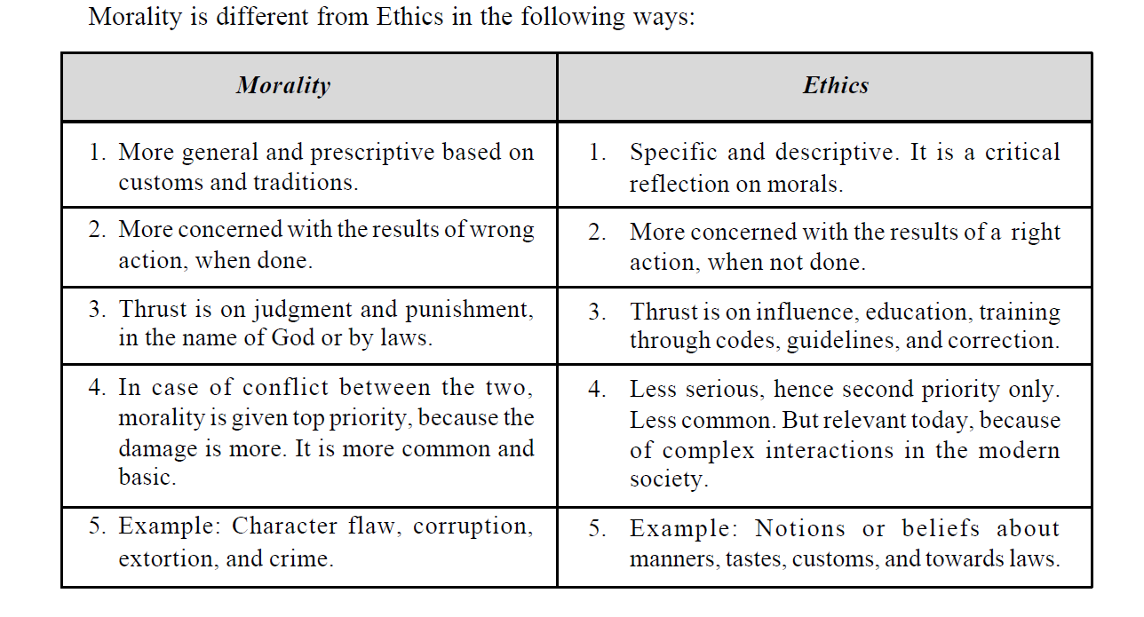
Morality Ethics

Slide 10
VALUES
A value is defined as a principle that promotes well-being or prevents harm.” Another definition
is: Values are our guidelines for our success—our paradigm about what is acceptable.” Personal values
are defined as: “Emotional beliefs in principles regarded as particularly favorable or important for the
individual.” Our values associate emotions to our experiences and guide our choices, decisions and
actions.
Types of Values
The five core human values are: (1) Right conduct, (2) Peace, (3) Truth, (4) Love, and (5) Nonviolence.

Slide 11
Scope
The scope of engineering ethics are twofold:
1. Ethics of the workplace which involves the co-workers and employees in an organization.
2. Ethics related to the product or work which involves the transportation, warehousing, and use, besides the safety of the end product and the environment outside the factory.
Approach
There are conventionally two approaches in the study of ethics:
1. Micro-ethics which deals with decisions and problems of individuals, professionals, and
companies.
2. Macro-ethics which deals with the societal problems on a regional/national level. For example, global issues, collective responsibilities of groups such as professional societies and consumer groups.

Slide 12
SENSES OF ENGINEERING ETHICS
The word ‘ethics’ has several distinct although related meanings.
The normative sense include
(i) It is an activity and area of inquiry. It is the activity of understanding moral values, finding accurate solutions to moral problems and justifying moral judgments in engineering practices
(ii) When we speak of ethical problems, issues and controversies, it means to distinguish them from non-moral problems. Study of decisions, policies, and values that are morally desirable in the engineering practice and research
(iii) The category of normative ethics involves creating or evaluating moral standards
The descriptive sense is
• It is used to refer to particular set of beliefs, attitudes, and habits that a person or group displays concerning morality. This is purely factual matter about what engineers and others believe about moral problems in engineering
• It simply involves describing how people behave and/or what sorts of moral standards they claim to follow

Slide 13
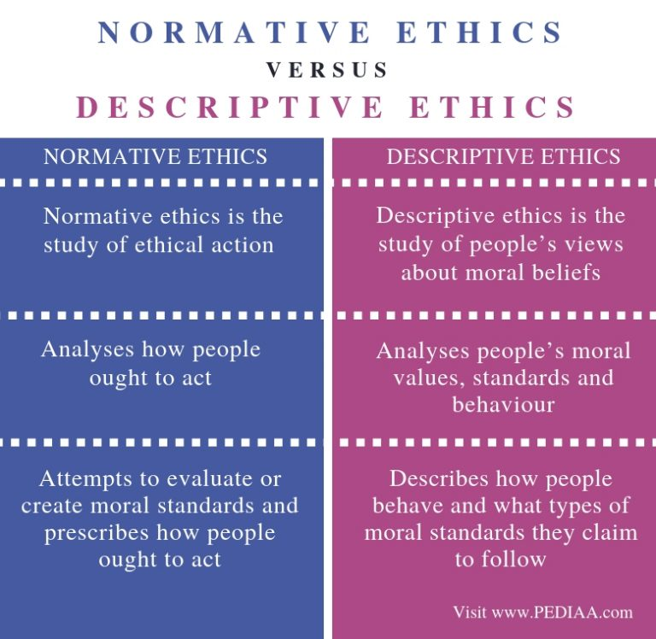

Slide 14
A description is just what you think it is: It describes a situation or what a philosopher might call a state of affairs. For example, “The car is red,” “The river is flowing quickly,” “I’m sad that my juicer is broken,” “Brutus killed Caesar.”
A normative statement is a claim about how things ought to be. For example, “Jazz is better than pop music,” “If you want to pass the exam you should study,” “Killing an innocent person is wrong.”
Descriptive Claim Normative Claim
No one knows what happens after death. No one should fear death.

Slide 15
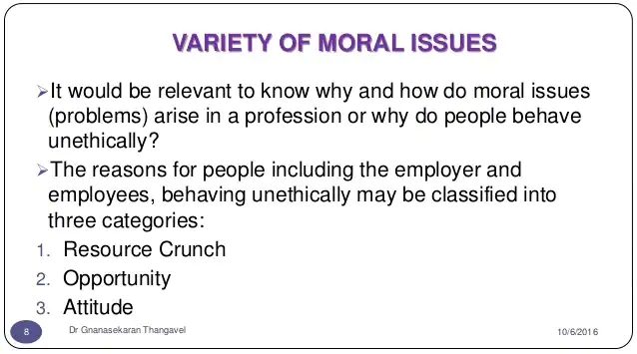

Slide 16
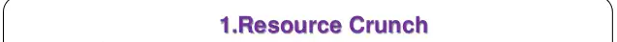
A critical moment or situation, especially one that occurs because of a shortage of time or resources: a year-end crunch; an energy crunch. c. A period of financial difficulty characterized by tight money and unavailability of credit.

Slide 17
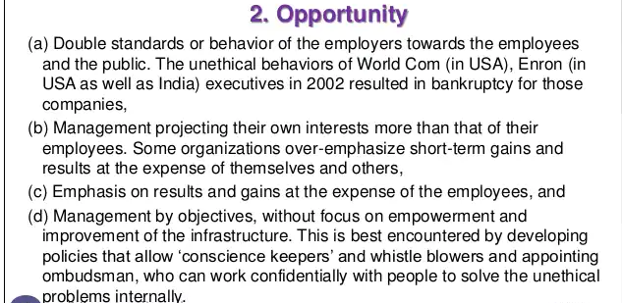

Slide 18
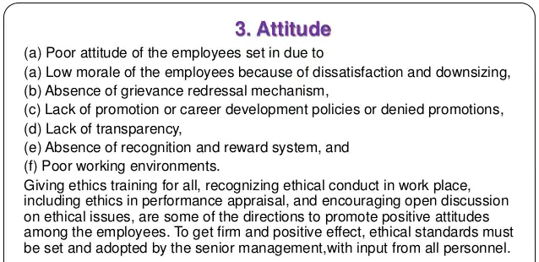

Slide 19
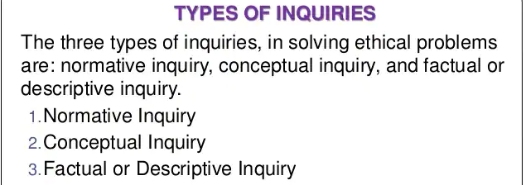

Slide 20
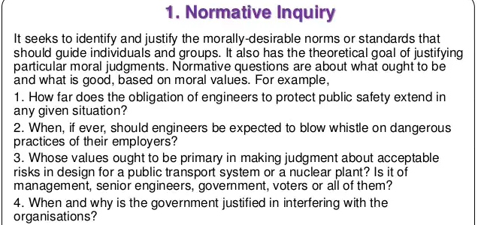

Slide 21
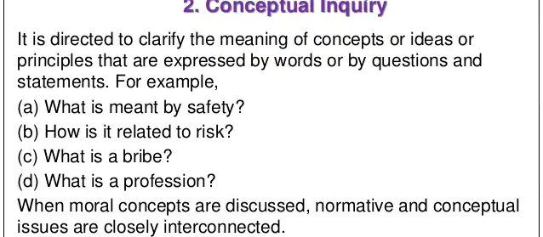

Slide 22
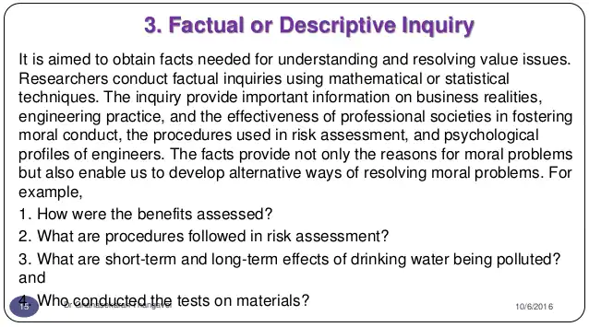

Slide 23
MORAL DILEMMA
Definition
Dilemmas are situations in which moral reasons come into conflict, or in which the application of moral values are problems, and one is not clear of the immediate choice or solution of the problems.
Moral reasons could be rights, duties, goods or obligations. These situations do not mean that things had gone wrong, but they only indicate the presence of moral complexity. This makes the decision making complex. For example, a person promised to meet a friend and dine, but he has to help his uncle who is involved in an accident — one has to fix the priority.
  There are some difficulties in arriving at the solution to the problems, in dilemma. The three complex situations leading to moral dilemmas are:

Slide 24
A moral dilemma is a conflict in which a person must choose between two or more actions, all of which they have the ability to do. There are moral reasons for each choice. No matter which choice you make, someone will suffer or something bad will happen. In order to help you understand exactly what is meant by “moral dilemma” we have provided some examples, some of which are classic moral dilemma
Example:
A Difficult Choice
You and your family love the beach and decide to spend a weekend at an isolated beach cabin. Your teenage daughter often gets bored on your getaways, so you make plans to take your niece along. As soon as you arrive, a storm is looming on the horizon and the water looks rough. You tell the girls they can get ready to swim, but to come back and help unload the car. They are so excited, they do not pay attention to the last part of what you say and run down to the beach to swim. You do not realize they have done so until you hear your daughter scream. You realize they are both caught in a strong current and might be swept out to sea. You are a good swimmer and know you can save one of them. You have a difficult choice to make. Do you:
Save your niece first as she is a poor swimmer and will not be able to last as long as your daughter?
Save your daughter first, because, although she is a strong swimmer and may be able to last long enough for you to come back after saving your niece, you cannot stand the idea of losing her?

Slide 25
Telling a Secret
Your friend tells you that they committed a crime. They explain that they are having trouble sleeping at night and feel you are the only one they can trust with their confession. A few days later, you read in the paper that someone has been arrested for your friend’s crime. Do you:
Go to the police and tell them what you know?
Encourage your friend to confess and warn him if he does not do so, you will tell?
Say nothing because you will not betray a friend’s confidence?

Slide 26
  There are some difficulties in arriving at the solution to the problems, in dilemma. The three complex situations leading to moral dilemmas are:
1. The problem of vagueness: One is unable to distinguish between good and bad (right or wrong) principle. Good means an action that is obligatory. For example, code of ethics specifies that one should obey the laws and follow standards. Refuse bribe or accept the gift, and maintain confidentiality
2. The problem of conflicting reasons: One is unable to choose between two good moral solutions. One has to fix priority, through knowledge or value system.
3. The problem of disagreement: There may be two or more solutions and none of them mandatory. These solutions may be better or worse in some respects but not in all aspects. One has to interpret, apply different morally reasons, and analyze and rank the decisions. Select the best suitable, under the existing and the most probable conditions

Slide 27
Problem of vagueness
^{ü} Vague means not clearly expressed or perceived; not specific or exact.
^{ü} For a given situation, sometimes it is unclear to the engineers to apply the most appropriate moral considerations or principles. They may not know how and which moral principles to be used in resolving a moral problem. This situation creates a typical moral dilemma.
^{ü} Example: consider an engineer, starting a new assignment as quality inspector checking the incoming raw materials/spare parts from the suppliers. Supplier offers (on behalf of some festival, say, Deepavali) him an expensive DVD player as a gift.
Now this situation is a moral dilemma. Because the engineer is unclear about: what to do?; whether to accept the gift or not?; whether the thing offered is a gift or a bribe?; will it create a conflict of interest?
Thus the problem of vagueness i.e., unclarity causes a moral dilemma.

Slide 28
The problem of conflicting reasons
Example: let us examine the space shuttle challenger explosion, focusing on the dilemma faced by the engineering manager, bob lund. He had the following conflicts:
1. Launching the chelenger space shuttle despite there was an unknown probability that the shuttle would explode; which will kill all the persons on the board.
2. Postponing the launch, which may lead to loss of future contracts from NASA, the loss of job to many workers, etc.
Now, the job of Bob Lund is to make the best choice out of these two conflicts. At last, he chose to risk the launching of shuttle.
This situation is one of the good illustrations for the moral dilemma due to the problem of conflicting reasons.

Slide 29
The problem of disagreement
Example: In most corporations, there are disagreements among managers regarding whether customer can be allowed to inspect their plants and procedures, as a confidence building measure

Slide 30
The logical steps in confronting moral dilemma are:
1. Identification of the moral factors and reasons. The clarity to identify the relevant moral values from among duties, rights, goods and obligations is obtained (conceptual inquiry). The most useful resource in identifying dilemmas in engineering is the professional codes of ethics, as interpreted by the professional experience. Another resource is talking with colleagues who can focus or narrow down the choice of values.
2. Collection of all information, data, and facts (factual inquiry) relevant to the situation.
3. Rank the moral options i.e., priority in application through value system, and also as obligatory, all right, acceptable, not acceptable, damaging, and most damaging etc. For example, in fulfilling responsibility, the codes give prime importance to public safety and protection of the environment, as compared to the individuals or the employers (conceptual inquiry).

Slide 31
MORAL AUTONOMY
Moral autonomy is defined as, decisions and actions exercised on the basis of moral concern for other people and recognition of good moral reasons. Alternatively, moral autonomy means ‘self determinant or independent’. The autonomous people hold moral beliefs and attitudes based on their critical reflection rather than on passive adoption of the conventions of the society or profession. Moral autonomy may also be defined as a skill and habit of thinking rationally about the ethical issues, on the basis of moral concern.

Slide 32
Moral Autonomy is the philosophy which is self-governing or self-determining, i.e., acting independently without the influence or distortion of others. The moral autonomy relates to the individual ideas whether right or wrong conduct which is independent of ethical issues. The concept of moral autonomy helps in improving self-determination.
Moral Autonomy is concerned with independent attitude of a person related to moral/ethical issues. This concept is found in moral, ethical and even in political philosophy.

Slide 33
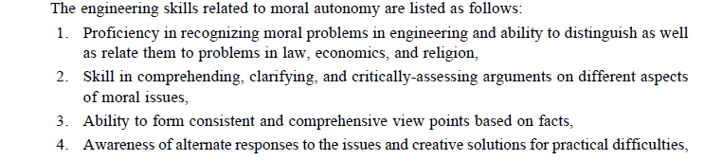
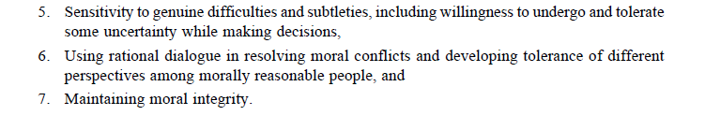

Slide 34
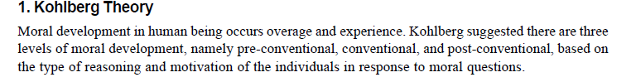
MORAL DEVELOPMENT (THEORIES)
Kohlberg's theory of moral development is a theory that focuses on how children develop morality and moral reasoning. Kohlberg's theory suggests that moral development occurs in a series of six stages. The theory also suggests that moral logic is primarily focused on seeking and maintaining justice.

Slide 35
Lawrence Kohlberg was, for many years, a professor at Harvard University. He became famous for his work there beginning in the early 1970s. He started as a developmental psychologist and then moved to the field of moral education. He was particularly well-known for his theory of moral development which he popularized through research studies conducted at Harvard's Center for Moral Education.
His theory of moral development was dependent on the thinking of the Swiss psychologist Jean Piaget and the American philosopher John Dewey. He was also inspired by James Mark Baldwin. These men had emphasized that human beings develop philosophically and psychologically in a progressive fashion.
Kohlberg believed...and was able to demonstrate through studies...that people progressed in their moral reasoning (i.e., in their bases for ethical behavior) through a series of stages. He believed that there were six identifiable stages which could be more generally classified into three levels.

Slide 36
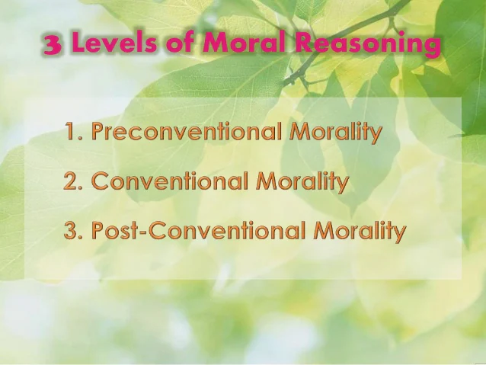

Slide 37
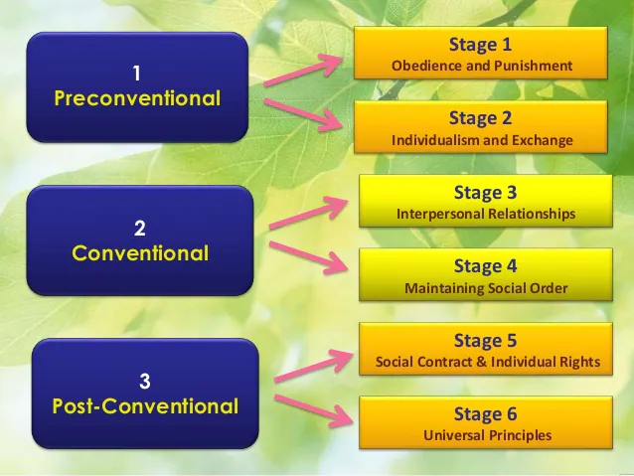

Slide 38
The first level of moral thinking is that generally found at the elementary school level. In the first stage of this level, people behave according to socially acceptable norms because they are told to do so by some authority figure (e.g., parent or teacher). This obedience is compelled by the threat or application of punishment. The second stage of this level is characterized by a view that right behavior means acting in one's own best interests.
The second level of moral thinking is that generally found in society, hence the name "conventional." The first stage of this level (stage 3) is characterized by an attitude which seeks to do what will gain the approval of others. The second stage (stage 4)is one oriented to abiding by the law and responding to the obligations of duty.

Slide 39
The third level of moral thinking is one that Kohlberg felt is not reached by the majority of adults. Its first stage (stage 5) is an understanding of social mutuality and a genuine interest in the welfare of others. The last stage (stage 6) is based on respect for universal principle and the demands of individual conscience.
Kohlberg believed that individuals could only progress through these stages one stage at a time. That is, they could not "jump" stages. They could not, for example, move from an orientation of selfishness to the law and order stage without passing through the good boy/girl stage

Slide 40
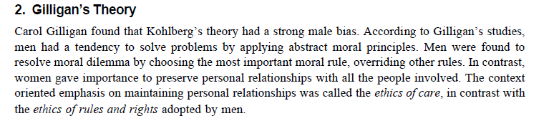
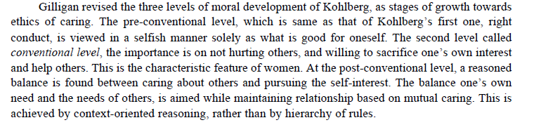

Slide 41
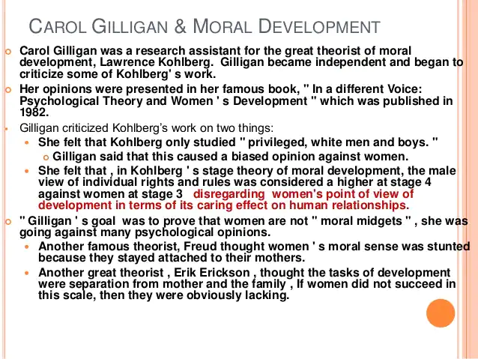

Slide 42
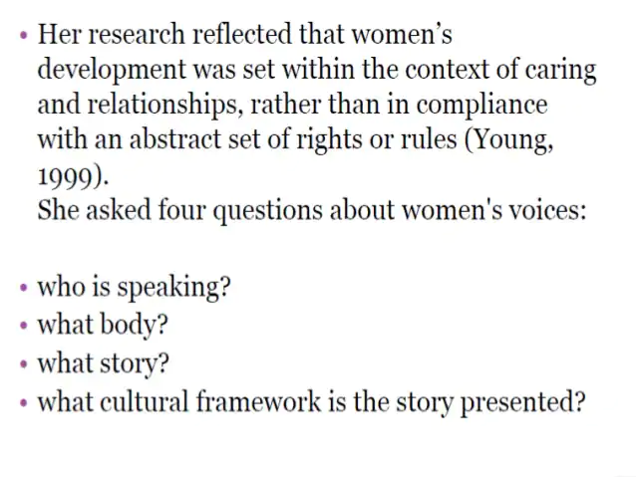

Slide 43
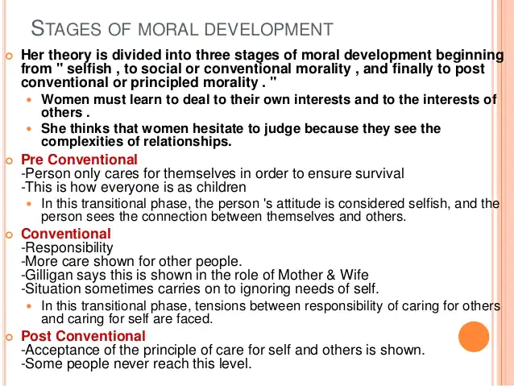

Slide 44
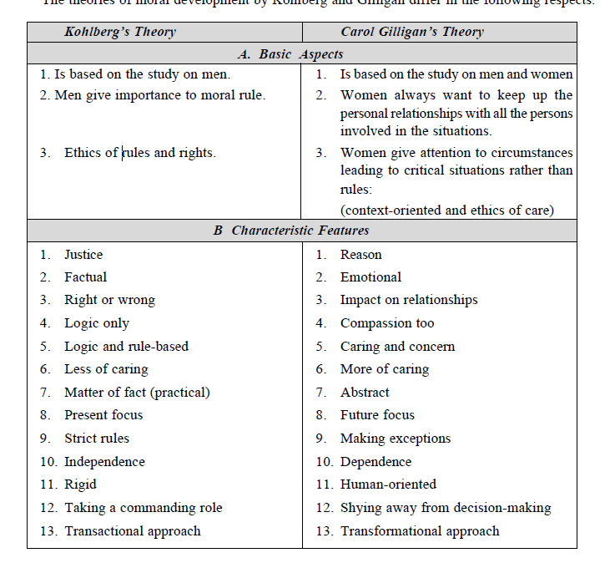

Slide 45
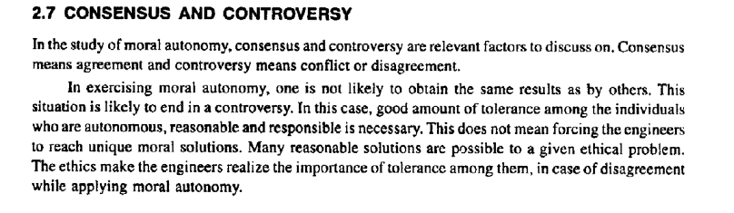

Slide 46
Consensus and Controversy
^{ü} Literally, consensus means ‗agreement‘, and controversy means ‗disagreement‘.
^{ü} When an individual exercise moral autonomy, he may not be able to attain the same results as other people obtain in practicing their moral autonomy. Here there might be some differences in the practical application of moral autonomy. This kind of controversies i.e., disagreements are inevitable.
Since exercising moral autonomy is not as precise and clear-cut as arithmetic, therefore the moral disagreements are natural and common. So in order to allow scope for disagreement, the tolerance is required among individuals with autonomous, reasonable and responsible thinking.
^{ü} According to the principle of tolerance, the objective of teaching and studying engineering ethics is to discover ways of promoting tolerance in the exercise of moral autonomy by engineers.

Slide 47
Thus the goal of teaching engineering ethics is not merely producing always a unanimous moral conformity; it is about finding the proper ways and means for promoting tolerance in the practical applications of moral autonomy by engineers.
^{ü} In a way, the goal of courses on engineering ethics and goals of responsible engineering have some similarities. Both situations require the need for some consensus regarding the role of authority.

Slide 48
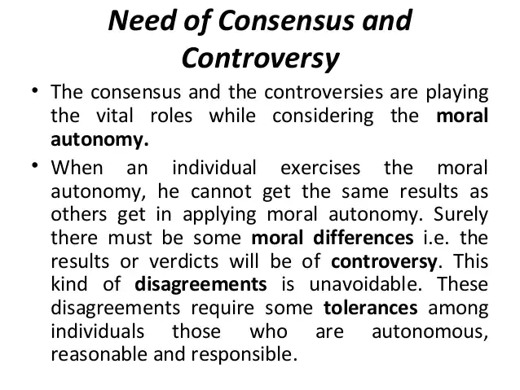
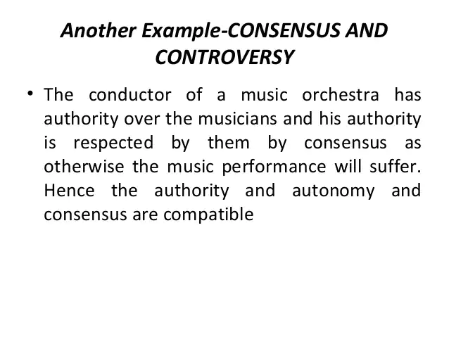

Slide 49
Profession
Profession means a job or an occupation, that helps a person earn his living. The main criteria of a profession involves the following.
Advanced expertise − The criteria of a profession is to have sound knowledge in both technical aspects and liberal arts as well. In general, continuing education and updating knowledge are also important.
Self-regulation − An organization that provides a profession, plays a major role in setting standards for the admission to the profession, drafting codes of ethics, enforcing the standards of conduct and representing the profession before the public and the government.
Public good − Any occupation serves some public good by maintaining high ethical standards throughout a profession. This is a part of professional ethics where each occupation is intended to serve for the welfare of the public, directly or indirectly to a certain extent.

Slide 50
Profession is a disciplined group of individuals who adhere to ethical standards and who hold themselves out as, and are accepted by the public as possessing special knowledge and skills in a widely recognised body of learning derived from research, education and training at a high level, and who are prepared to apply this knowledge and exercise these skills in the interest of others.
It is inherent in the definition of a Profession that a code of ethics governs the activities of each Profession. Such codes require behaviour and practice beyond the personal moral obligations of an individual. They define and demand high standards of behaviour in respect to the services provided to the public and in dealing with professional colleagues. Often these codes are enforced by the Profession and are acknowledged and accepted by the community.
A profession is what you do.

Slide 51
Characteristics
The characteristics of the ‘profession’ as distinct from ‘non-professional occupation’ are listed as follows:
1. Extensive Training
Entry into the profession requires an extensive period of training of intellectual (competence) and moral (integrity) character. The theoretical base is obtained through formal education, usually in an academic institution. It may be a Bachelor degree from a college or university or an advanced degree conferred by professional schools.
2. Knowledge and Skills
Knowledge and skills (competence) are necessary for the well-being of the society. Knowledge of physicians protects us from disease and restores health. The lawyer’s knowledge is useful when we are sued of a crime, or if our business is to be merged or closed or when we buy a property. The Chartered Accountant’s knowledge is important for the success of recording financial transactions or when we file the income return. The knowledge, study, and research of the engineers are required for the safety of the air plane, for the technological advances and for national defense.

Slide 52
3Monopoly
The monopoly control is achieved in two ways:
(a) the profession convinces the community that only those who have graduated from the professional school should be allowed to hold the professional title. The profession also gains control over professional schools by establishing accreditation standards
(b) By persuading the community to have a licensing system for those who want to enter the profession. If practicing without license, they are liable to pay penalties.
4. Autonomy in Workplace
Professionals engaged in private practice have considerable freedom in choosing their clients or patients. Even the professionals working in large organizations exercise a large degree of impartiality, creativity and discretion (care with decision and communication) in carrying their responsibilities. Besides this, professionals are empowered with certain rights to establish their autonomy.
5. Ethical Standards
Professional societies promulgate the codes of conduct to regulate the professionals against their abuse or any unethical decisions and actions (impartiality, responsibility) affecting the individuals or groups or the society.

Slide 53
PROFESSIONAL
Traditionally, a ‘Professional‘ is someone who derives their income from their specific knowledge or experience – as opposed to a worker, hobbyist or amateur without formal education
A Professional is a member of a Profession. Professionals are governed by codes of ethics and profess commitment to competence, integrity and morality, altruism and the promotion of the public good within their expert domain. Professionals are accountable to those they serve and to society
Professional is single entity and an expert in a specialised field of job who earns by selling his/her services
Professional means the person who knows his work better than anyone.
The term professional refers to anyone who earns their living from performing an activity that requires a certain level of education, skill, or training. There is typically a required standard of competency, knowledge, or education that must be demonstrated (often in the form of an exam or credential), as well as adhering to codes of conduct and ethical standards.

Slide 54
Types of professionals include:
Accountant
Teacher
Technician
Laborer
Physical
Commercial Banker
Engineer
Lawyer
Psychologist
Pharmacist
Dietitian
Research Mechanic
Dentist
Electrician
Consultant
Programmer

Slide 55
Professional standards are a set of practices, ethics, and behaviors that members of a particular professional group must adhere to. These sets of standards are frequently agreed to by a governing body that represents the interests of the group.
Examples of professional standards include:
Accountability – takes responsibility for their actions
Confidentiality – keeps all sensitive information private and away from those who shouldn’t have access to it
Fiduciary duty – places the needs of clients before their own
Honesty – always being truthful
Integrity – having strong moral principles
Law-abiding – follows all governing laws in the jurisdictions they perform activities
Loyalty – remain committed to their profession
Objectivity – not swayed or influenced by biases
Transparency – revealing all relevant information and not concealing anything

Slide 56
PROFESSIONALISM
‘Professionalism’ is defined as the personally held beliefs of a Professional about their own conduct as a member of a Profession. It is often linked to the upholding of the principles, laws, ethics and conventions of a Profession in the form of a code of practice.
“The skill, good judgment, and polite behavior that is expected from a person who is trained to do a job well”
Professionalism’ is commonly understood as an individual’s adherence to a set of standards, code of conduct or collection of qualities that characterize accepted practice within a particular area of activity”

Slide 57
Professionalism covers comprehensively all areas of practice of a particular profession. It requires skills and responsibilities involved in engineering profession. Professionalism implies a certain set of attitudes.
The art of Professionalism can be understood as the practice of doing the right thing, not because how one feels but regardless of how one feels. Professionals make a profession of the specific kind of activity and conduct to which they commit themselves and to which they can be expected to conform. Moral ideals specify virtue, i.e., desirable feature of character. Virtues are desirable ways of relating to other individuals, groups and organizations. Virtues involve motives, attitudes and emotions.
According to Aristotle, virtues are the “acquired habits that enable us to engage effectively in rational activities that defines us as human beings.”

Slide 58
Professional Ideals and Virtues
The virtues represent excellence in core moral behavior. The essentials for any professional to excel in the profession are behavior, skills and knowledge. The behavior shows the moral ideology of the professional.
The moral ideals specify the virtue, i.e., the desirable character traits that talk a lot about the motives, attitude and emotions of an individual.
Public spirited virtues
Proficiency virtues
Team work virtues
Self-governance virtues
The virtues mentioned above show the professional responsibility of an individual. Hence, the professionalism that comes in with these virtues is called Responsible Professionalism. Let us now understand each virtue in detail.

Slide 59
Public-spirited Virtues
An engineer should focus on the good of the clients and the public at large, which means no harm should be done intentionally. The code of professional conduct in the field of engineering includes avoiding harm and protecting, as well promoting the public safety, health and welfare.
Maintaining a sense of community with faith and hope within the society and being generous by extending time, talent and money to professional societies and communities, an engineer can maintain the public-spirited virtue. Finally, justice within corporations, government and economic practices becomes an essential virtue that an engineer should always possess.
Proficiency Virtues
These refer to the virtues followed in the profession according to the talent and intellect of an engineer. The moral values that include this virtue are competence and diligence. The competence is being successful in the job being done and the diligence is taking care and having alertness to dangers in the job. Creativity should also be present in accomplishing the assigned task

Slide 60
Teamwork Virtues
These virtues represent the coordination among team members which means working successfully with other professionals. These include cooperative nature along with loyalty and respect towards their organization, which makes the engineers motivate the team professionals to work towards their valuable goals.
Self-governance Virtues
These virtues are concerned with moral responsibilities which represent integrity and self-respect of the person. The integrity actually means the moral integrity which refers to the actions, attitude and emotions of the person concerned during his professional period.
The self-governance virtues center on commitment, courage, self-discipline, perseverance, self-respect and integrity. The truthfulness and trustworthiness which represent his honesty are the crucial moral values to be kept up by a professional.

Slide 61
Here are 12 ways you can develop and practice professionalism:
Be productive
Use your time productively at work. Focus on your job responsibilities and avoid getting pulled into social media, web browsing and phone activity while on the clock.
Develop a professional image
Project a professional presence and dress appropriately for your industry and organization. A good rule of thumb is to dress in the position you aspire to have.
Take the initiative
Ask for more projects to be given to you or think of assignments that will meet your organization's goals. You don’t want to be under-utilized.
Maintain effective work habits
Prioritize, plan and manage your assignments and projects. Follow up and follow through with your supervisor and team members.

Slide 62
5. Manage your time efficiently
Establish priorities, set goals and create action plans to meet deadlines.
6.Demonstrate integrity
Be accountable for your work and actions while behaving ethically at all times.
7.Provide excellence
Produce work and results that reflect a sense of pride and professionalism, often exceeding expectations.
8.Be a problem-solver
When you run into problems and obstacles take the time to brainstorm a few solutions and alternatives before you meet with your supervisor.

Slide 63
9.Be resilient
Develop coping skills to manage setbacks and challenges with a positive and constructive attitude.
10.Communicate effectively
Practice professional on-line, in person and interpersonal communication skills.
11.Develop self-awareness
Learn to manage your emotions and gain awareness of your emotional triggers so you can manage your reactions positively and productively. Accept and reflect on feedback to assist as you learn and grow.
12.Build relationships
Network with colleagues, customers and clients to build professional cordial relationships, work on teams and collaborate effectively.

Slide 64
MODELS OF PROFESSIONAL ROLES
Promotion of public good is the primary concern of the professional engineers. There are several role models to whom the engineers are attracted. These models provoke their thinking, attitudes and actions.
1. Savior
The engineer as a savior, save the society from poverty, illiteracy, wastage, inefficiency, ill health, human (labor) dignity and lead it to prosperity, through technological development and social planning.
For example, R.L. Stevenson.
2. Guardian
He guards the interests of the poor and general public. As one who is conversant with technology development, is given the authority befitting his expertise to determine what is best suited to the society. For example, Lawrence of Arabia (an engineer).

Slide 65
3. Bureaucratic Servant
He serves the organization and the employers. The management of an enterprise fixes its goals and assigns the job of problem solving to the engineer, who accepts the challenge and shapes them into concrete achievements. For example, Jamshedji Tata.
4. Social Servant
It is one who exhibits social responsibility. The engineer translates the interest and aspirations of the society into a reality, remembering that his true master is the society at large. For example, Sir M.Viswesvarayya.
5. Social Enabler and Catalyst
One who changes the society through technology. The engineer must assist the management and the society to understand their needs and make informed decisions on the desirable technological development and minimize the negative effects of technology on people and their living environment. Thus, he shines as a social enabler and a catalyst for further growth. For example, Sri Sundarlal Bahuguna.
6. Game Player
He is neither a servant nor master. An engineer is an assertive player, not a passive player who may carry out his master’s voice. He plays a unique role successfully within the organization, enjoying the excitement of the profession and having the satisfaction of surging ahead in a competitive world. For example, Narayanamurthy, Infosys and Dr. Kasthurirangan, ISRO.

Slide 66
RESPONSIBILITY
Senses
There are different senses of responsibility, such as:
1. Characteristic Quality
Primarily responsibility implies duty with care and efforts.
2. Obligations
These are one’s moral responsibility i.e., duty to act right and in moral ways. The obligations such as honesty, fairness, and decency are incumbent on every one. In addition to this, we have role responsibilities assigned by taking up various roles, such as parents, inspectors, and employees. For example, a Safety Engineer has a responsibility to make regular inspections in a
3. General Moral Capacity
One has the general capacity for moral agency, including the understanding and action on moral
reasons.
4. Liability and Accountability
Liability and Accountability for actions. It means that one is liable (with a legal sense) to meet the
obligations in better ways. The person is likely to respond legally, if necessary.

Slide 67
Accountable means that one is willing to justify or defend the decisions, actions or means and outcomes. It could include offering a reasonable excuse or accepting the shame for not having met the end results or accepting the guilt for harming others. One is also answerable to the assessment by others on one’s actions (means) or outcomes.
5. Praiseworthiness/Blameworthiness
When accountability for wrong actions or results is at issue, responsibility means blameworthy. When the right conduct or successful result is at issue, responsible is synonymous with praiseworthy. factory shops.

Slide 68
Different types of responsibilities exhibited in human transactions are:
1. Moral Responsibility
Moral responsibility as applied to a professional: A professional must be responsible morally, in creating internal good or good outcomes, and eliminating /minimizing un- intended side-effects, from engineering and technology. It includes:
(a) Obligations: A commitment to moral actions (primary obligation to protect the safety of the
human beings and respect their rights),
(b) Conscientious: A comprehensive perspective to accept the duties, and diligently do the right
things by putting their heart, head and hands (awareness of the experimental nature of the
product/project, anticipating possible and unexpected outcomes and putting efforts to monitor
them),
(c) Accountability (being accountable for the decisions, actions, and the results of product/
project including safety), and
(d) Praiseworthy/Blameworthy as applied to context of doing things right/doing things wrongly,
respectively

Slide 69
2. Causal Responsibility
It is being a cause of some event. For example, a child playing with matches cause a house to burn. The child is causally responsible, but the parent who left the child with matches, is morally responsible.
3. Job Responsibility
It consists of assigned tasks at the place of employment and achieving the objectives.
4. Legal Responsibility
It is the response required by law and includes legal obligations and accountability to meet them. Many of these responsibilities overlap with moral responsibility

Slide 70
Social Responsibility
Corporate organizations have social responsibility to all of their ‘stakeholders’. This includes the wellbeing of the employees and their unions, socially responsible investors, customers, dealers, suppliers, local communities, governments, non-governmental organizations, and the business owners and managers. Besides showing concern with employee relations and other internal organizational matters, the organization is concerned with
(a) how the product/project is marketed, used or misused, how it fails, and how it is disposed or discarded. The ways in which the used battery cells and computers are discarded have been debated in the engineers’ forums.
(b) protecting the work environment during manufacture as well as the external environment during transport or use
(c) training the disadvantaged or physically-challenged workers
(d) subcontracting and hiring practices, and
(e) contribution to local communities to enrich their cultural, social, and civic life. It may be even compensatory against the harm to environment (e.g., planting trees).

Slide 71
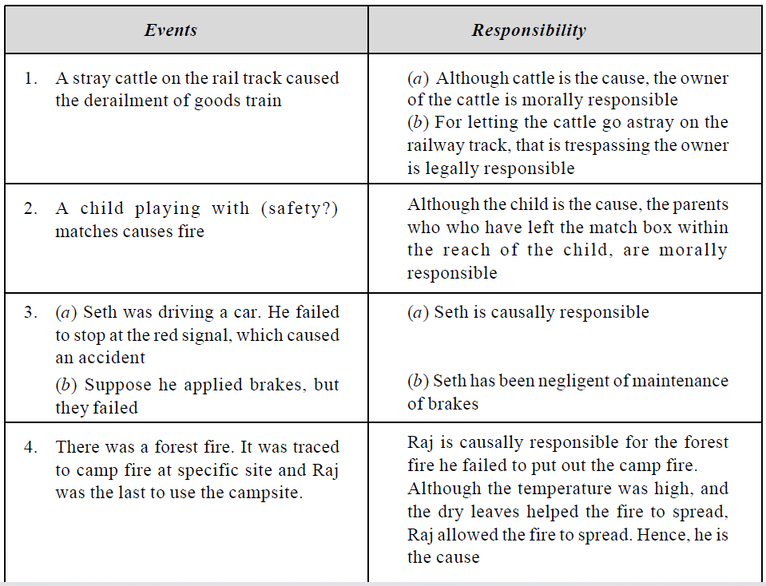

Slide 72
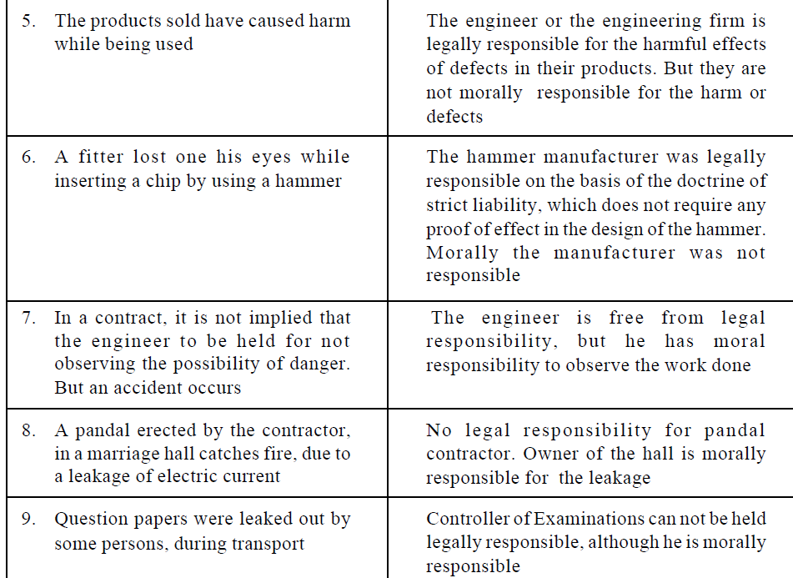

Slide 73
EthicalApproaches
Several ethical theories have been developed over different times, each of them stressing certain ethical principles or features. Each stresses a view and many a times, we find that these theories converge and reinforce the ethics, in deciding upon the actions and justifying the results
Utilitarian Theory
Utilitarianism is a tradition of ethical philosophy that is associated with Jeremy Bentham and John Stuart Mill, two late 18th- and 19th-century British philosophers, economists, and political thinkers. Utilitarianism holds that an action is right if it tends to promote happiness and wrong if it tends to produce sadness, or the reverse of happiness—not just the happiness of the actor but that of everyone affected by it. At work, you display utilitarianism when you take actions to ensure that the office is a positive environment for your co-workers to be in, and then make it so for yourself.

Slide 74
Utilitarian theory
Classical Utilitarianism
An example of utilitarianism that shows someone making an individual “good” choice that actually benefits the entire population can be seen in Bobby’s decision to buy his sister, Sally, a car. Bobby buys Sally the car so that she can get back and forth to work. Because Sally can now go to work, she can now accept the job with ABC Company. ABC Company has had trouble filling that position for quite some time, and it was an important one, so now the company can get a better handle on crucial business decisions.
As it stands, ABC Company does a lot of international business, and Sally is put in charge of their accounts. The continued business between ABC company and its international clients helps the global economy thrive, as people the world over remain employed; perhaps being given raises or promotions. In Bobby’s act of buying Sally a car, an act that could otherwise be seen as his making Sally happy on an individual level, he acted in such a way as to benefit the world at large.

Slide 75
Duty-based or Deontological ethics
Deontological (duty-based) ethics are concerned with what people do, not with the consequences of their actions.
Do the right thing.
Do it because it's the right thing to do.
Don't do wrong things.
Avoid them because they are wrong.
Under this form of ethics you can't justify an action by showing that it produced good consequences, which is why it's sometimes called 'non-Consequentialist'.
The word 'deontological' comes from the Greek word deon, which means 'duty'.
Duty-based ethics are usually what people are talking about when they refer to 'the principle of the thing'.
Duty-based ethics teaches that some acts are right or wrong because of the sorts of things they are, and people have a duty to act accordingly, regardless of the good or bad consequences that may be produced.

Slide 76
Duty
When you make a decision, you need to ask yourself who you owe a duty to and which is more important. So, if your sister asks you to steal something for her, you owe a duty to her in that she is your sister, but you also owe an equal duty to the person you are stealing from. Duty-based ethics are the assessment of whom you owe a greater duty to.
Workplace Example
Assume your colleague asks you to lie to your boss. Your colleague wants you to tell your boss he is out on a sales call when in reality he is having a wet lunch in a bar. You need to assess who you owe a greater duty to—your boss, who pays your paycheck and has always treated you well, or your colleague, whose friendship is valuable to you.
Real World Example
Assume that at the end of the day, you go shopping on your way home. In the parking lot, you bump into someone else's car. Nobody sees. Now, you need to assess your duties—do you owe a greater duty to yourself or the other person? Duty-based ethics promote respect for other people, so in this case you need to leave a note in order to stay within duty-based ethics.

Slide 77
RIGHTS THEORY
There are some rights, both positive and negative, that all humans have based only on the fact that they are human.
These rights can be natural or conventional.
Natural rights are those that are inherent while conventional rights are those created by humans and that reflect society's values.
Rights-Based Ethics System: Examples
The term right can be defined as "a justified claim that individuals and groups can make upon other individuals or upon society." Rights-based ethics means that ethical behavior must uphold the rights of people, such as civil rights within a democracy. Rights can be legal in nature, or they can pertain to morality or human rights.

Slide 78
The right to life
The right to liberty
The right to pursue happiness
The right to a jury trial
The right to a lawyer
The right to freely practice a religion of choice
The right to express ideas or opinions with freedom as an individual
The right to come together and meet in order to achieve goals
The right to be informed of what law has been broken if arrested

Slide 79
The right to call witnesses to speak on one's behalf if accused of a crime
The right of a person to be treated with respect and dignity
The right to freely live and travel within the country
The right to work
The right to marry
The right to bear children
The right to an education
The right to join any peaceful parties or groups of choice
The right to be free from slavery

Slide 80
he right to not be tortured
The right to be treated as equal to others
The right to be considered to be innocent until proven guilty
The right to personal privacy
The right to own property
In healthcare, The Code of Medical Ethics of the American Medical Association is an example of rights-based ethics. It defines patient rights and the duty of physicians to respect them.

Slide 81
A. The RIGHTS approach to ethics has its roots in the 18th century philosopher Immanuel Kant, who focused on the individual’s right to choose for oneself. According him, what makes human beings different from mere things is, that people have dignity based on their ability to choose freely what they will do with their lives, and they have a fundamental moral right to have these choices respected. People are not objects to be manipulated; it is a violation of human dignity to use people in ways they do not freely choose. Other rights he advocated are:
1. The right to access the truth: We have a right to be told the truth and to be informed about matters that significantly affect our choices.
2. The right of privacy: We have the right to do, believe, and say whatever we choose in our personal lives so long as we do not violate the rights of others.
3. The right not to be injured: We have the right not to be harmed or injured unless we
freely and knowingly do something to deserve punishment or we freely and knowingly
choose to risk such injuries.
4. The right to what is agreed: We have a right to what has been promised by those with
whom we have freely entered into a contract or agreement.

Slide 82
B. In deciding whether an action is moral or immoral, we must ask, does the action respect the
moral rights of everyone? Actions are wrong to the extent that they violate the rights of individuals; the more serious is the violation, the more wrongful is the action. The RIGHTS theory as promoted by John Locke states that the actions are right, if they respect human rights of every one affected. He proposed the three basic human rights, namely life, liberty, and property. His views were reflected in the modern American society, when Jefferson declared the basic rights as life, liberty, and pursuit of happiness.
C. As per A.I. Melden’s theory based on rights, nature mandates that we should not harm others’ life, health, liberty or property. Melden allowed welfare rights also for living a decent human life. He highlighted that the rights should be based on the social welfare system

Slide 83
D. Human rights: Human rights are explained in two forms, namely liberty rights and welfare rights.
Liberty rights are rights to exercise one’s liberty and stresses duties on other people not to interfere with one’s freedom. The four features of liberty rights (also called moral
rights), which lay the base for Government Administration, are:
1. Rights are natural in so far as they are not invented or created by government.
2. They are universal, as they do not change from country to country.
3. They are equal since the rights are the same for all people, irrespective of caste,
race, creed or sex.
4. They are inalienable i.e., one cannot hand over his rights to another person such as
selling oneself to slavery.
The Welfare Rights are the rights to benefit the needy for a decent human life, when one can not earn those benefits and when those benefits are available in the society.
E. Economic rights: In the free-market economy, the very purpose of the existence of the manufacturer, the sellers and the service providers is to serve the consumer. The consumer is eligible to exercise some rights9. The consumers’ six basic rights are: Right to Information, Right to Safety, Right to Choice, Right to be Heard, Right to Redressal, and Right to Consumer Education.

Slide 84
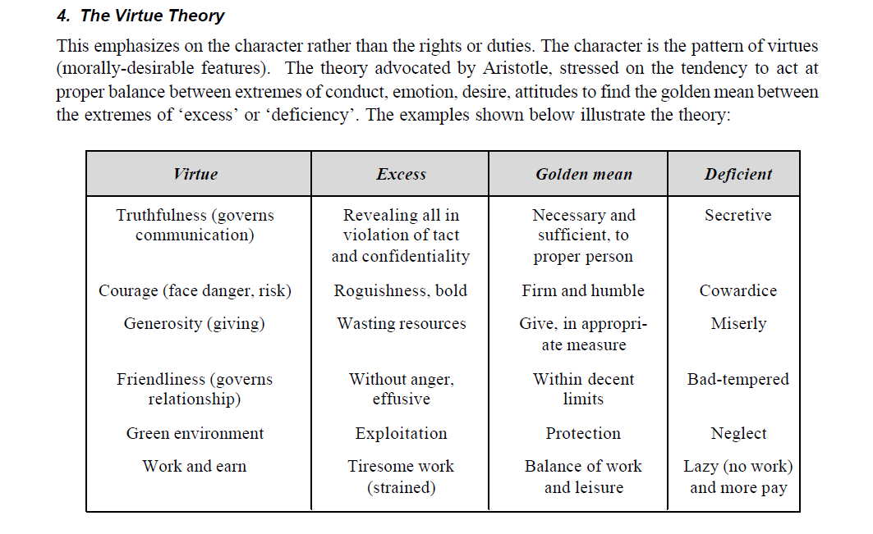

Slide 85
5.Justice Theory
Principles of Justice
The most fundamental principle of justice—one that has been widely accepted since it was first defined by Aristotle more than two thousand years ago—is the principle that "equals should be treated equally and unequals unequally." In its contemporary form, this principle is sometimes expressed as follows: "Individuals should be treated the same, unless they differ in ways that are relevant to the situation in which they are involved." For example, if Jack and Jill both do the same work, and there are no relevant differences between them or the work they are doing, then in justice they should be paid the same wages. And if Jack is paid more than Jill simply because he is a man, or because he is white, then we have an injustice—a form of discrimination—because race and sex are not relevant to normal work situations.
There are, however, many differences that we deem as justifiable criteria for treating people differently. For example, we think it is fair and just when a parent gives his own children more attention and care in his private affairs than he gives the children of others;
we think it is fair when the person who is first in a line at a theater is given first choice of theater tickets; we think it is just when the government gives benefits to the needy that it does not provide to more affluent citizens; we think it is just when some who have done wrong are given punishments that are not meted out to others who have done nothing wrong; and we think it is fair when those who exert more efforts or who make a greater contribution to a project receive more benefits from the project than others. These criteria—need, desert, contribution, and effort—we acknowledge as justifying differential treatment, then, are numerous.

Slide 86
6. Self-realisation Ethics
Right action consists in seeking self-fulfillment. In one version of this theory, the self to be realized is defined by caring relationships with other individuals and society. In another version called ethical egoism, the right action consists in always promoting what is good for oneself. No caring and society relationships are assumed.

Slide 87
SELF-CONTROL
It is a virtue of maintaining personal discipline. It means a strong will and motivation and avoidance of
fear, hatred, lack of efforts, temptation, self-deception, and emotional response. It encompasses courage and good judgment also. Self-respect promotes self-control
Self-control is what people use to restrain their desires and impulses. More precisely, it can be understood as the capacity to override one response(and substitute another).
It is largely synonymous with ‘self-regulation’, a term preferred by many researchers because of its greater precision

Slide 88
Self-interest
Self-interest is being good and acceptable to oneself. It is pursuing what is good for oneself.
It is very ethical to possess self-interest. As per utilitarian theory, this interest should provide for the respect of others also.
Duty ethics recognizes this aspect as duties to ourselves. Then only one can help others.
Right ethicist stresses our rights to pursue our own good. Virtue ethics also accepts the importance of self-respect as link to social practices.

Slide 89
RELIGION
Religions have played major roles in shaping moral views and moral values, over geographical regions.
Christianity has influenced the Western countries, Islam in the Middle-East countries, Buddhism and Hinduism in Asia, and Confucianism in China. Further, there is a strong psychological link between the
moral and religious beliefs of people following various religions and faiths. Religions support moral responsibility. They have set high moral standards. Faith in the religions provides trust and this trust inspires people to be moral. The religions insist on tolerance and moral concern for others.
Many professionals who possess religious beliefs are motivated to be morally responsible.

Slide 90
RELIGION
Each religion lays stress on certain high moral standards.
For example, Hinduism holds polytheistic (many gods) view, and virtues of devotion and surrender to high order.
Christianity believes in one deity and emphasizes on virtues of Love, Faith, and Hope.
Buddhism is non-theistic and focuses on compassion and Islam on one deity and adherence of ishan (piety or pursuit of excellence) and prayer.
Judaism stresses the virtue of ‘tsedakah’ (righteousness).

Slide 91
Divine Command Ethics
As per this principle, the right action is defined by the commands by God. It implies that to be moral, a person should believe in God and an action is right only if it is commanded by God.
There are some difficulties in this approach, namely, (a) whether God exists or not is not clear. (b) How to know what are the God’s commands? and (c) How to verify the genuineness of the commands?
Further, religions such as Hinduism, Islam, and Christianity accept the existence of God. But Buddhism, Taoism, and Confucianism adopt only faith in a right path and do not believe in God.

Slide 92
ENGINEERING AS SOCIAL EXPERIMENTATION
Before manufacturing a product or providing a project, we make several assumptions and trials, design and redesign and test several times till the product is observed to be functioning satisfactorily.
We try different materials and experiments. From the test data obtained we make detailed design and retests.
Thus, design as well as engineering is iterative processing as experimentation.
Several redesigns are made upon the feedback information on the performance or failure in the field or in the factory.
Besides the tests, each engineering project is modified during execution, based on the periodical feedback on the progress and the lessons from other sources.
Hence, the development of a product or a project as a whole may be considered as an experiment.

Slide 93
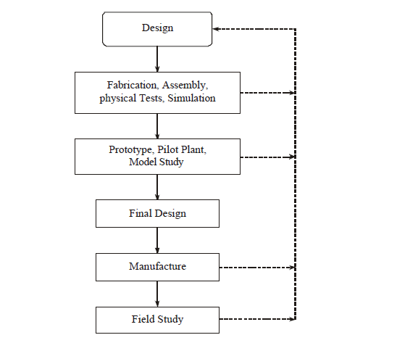

Slide 94
Similarities
1)Partial ignorance:
The project is usually executed in partial ignorance.
Uncertainties exist in the model assumed.
The behavior of materials purchased is uncertain and not constant (that is certain!).
They may vary with the suppliers, processed lot, time, and the process used in shaping the materials (e.g., sheet or plate, rod or wire, forged or cast or welded).
There may be variations in the grain structure and its resulting failure stress.

Slide 95
2)Uncertainty:
The final outcomes of projects are also uncertain, as in experiments. Some
times unintended results, side effects (bye-products), and unsafe operation have also occurred.
Unexpected risks, such as undue seepage in a storage dam, leakage of nuclear radiation from an atomic power plant, presence of pesticides in food or soft drink bottle, an new irrigation canal spreading water-borne diseases
3)Continuous monitoring:
Monitoring continually the progress and gaining new knowledge
are needed before, during, and after execution of project as in the case
of experimentation.
The performance is to be monitored even during the use (or wrong use!) of the product by the end user/beneficiary.rt

Slide 96
Learning from the past:
Engineers normally learn from their own prior designs and infer from the analysis of operation and results, and sometimes from the reports of other engineers.
But this does not happen frequently. The absence of interest and channels of communication, ego in not seeking information, guilty upon the failure, fear of legal actions, and mere negligence have caused many a failure
e.g., the Titanic lacked sufficient number of life boats—it had only 825 boats for the actual passengers of 2227, the capacity of the ship being
3547! In the emergent situation, all the existing life boats could not be
launched.

Slide 97
Contrasts
Experimental control:
In standard experiments, members for study are selected into two groups namely A and B at random. Group A are given special treatment. The group B is given no treatment and is called the ‘controlled group’. But they are placed in the same environment as the other group A. This process is called the experimental control.
This practice is adopted in the field of medicine. In engineering, this does not happen, except when the project is confined to laboratory experiments. This is because it is the clients or consumers who choose the product, exercise the control.
It is not possible to make a random selection of participants from various groups. In engineering, through random sampling, the survey is made from among the users, to assess the results on the product
Humane touch:
Engineering experiments involve human souls, their needs, views, expectations, and creative use as in case of social experimentation.
This point of view is not agreed by many of the engineers. But now the quality engineers and managers have fully realized this humane aspect.

Slide 98
INFORMED CONSENT:
Engineering experimentation is viewed as Societal Experiment since the subject and the beneficiary are human beings. In this respect, it is similar to medical experimentation on human beings.
In the case of medical practice, moral and legal rights have been recognized while planning for experimentation. Informed consent is practiced in medical experimentation. Such a practice is not there in scientific laboratory experiments.
Informed consent has two basic elements:
1. Knowledge: The subject should be given all relevant information needed to make the decision to participate.
2. Voluntariness: Subject should take part without force, fraud or deception. Respect for rights of minorities to dissent and compensation for harmful effect are assumed here

Slide 99
For a valid consent, the following conditions are to be fulfilled:
1. Consent must be voluntary
2. All relevant information shall be presented/stated in a clearly understandable form
3. Consenter shall be capable of processing the information and make rational decisions.
4. The subject’s consent may be offered in proxy by a group that represents many subjects of like-interests
Knowledge gained:
Not much of new knowledge is developed in engineering experiments as in the case of scientific experiments in the laboratory.
Engineering experiments at the most help us to (a) verify the adequacy of the design, (b) to check the stability of the design parameters, and (c) prepare for the unexpected outcomes, in the actual field environments.
From the models tested in the laboratory to the pilot plant tested in the field, there are differences in performance as well as other outcomes.

Slide 100
Engineers as Experimenters
The process of engineering lets you go through a series of different experiments when it comes to practical use.
Though it is not like an experiment in laboratory under controlled conditions, which is done while learning, an engineer should be ready to do the same on a social scale involving human subjects.
Experimentation is the main aspect of designing process.
An engineer who is ought to design the parts of a car, will be able to understand the result only when it is tested practically.
Preliminary simulations are conducted from time to time to know how the new concept of engineering acts in its first rough design.
Materials and processes are tried out, usually employing formal experimental techniques. Such tests serve as a basis, which help in developing the final product.

Slide 101
Engineers as Experimenters
In the process of developing a product, an engineer generally learns through experimentation.
To simply put, a trial and error method is the mostly used one to obtain results, but that goes with some calculations.
Hence, we can say that, primarily any experiment is carried out with partial ignorance. Even the outcomes of the experiments may not be as expected.
An engineer should always be ready for the unexpected output. The improvement of current prototype will lead to some change which may or may not be fruitful.
The experiments made are mostly subjected to risks though the project is small.
Many uncertainties are likely to occur depending upon the changes that might occur in the altered model or materials purchased.
At times, when the materials were subjected to continued stress and strain, or some process, it might happen that the nature of the substance changes which might lead to some destruction. These are the areas of experiment where nothing is really predictable.

Slide 102
Responsibility in Experimentation
Although the experiments and the results are uncertain, there are few things which an engineer is ought to keep in mind. Consider the following points which are related to the moral aspects of human behavior
To maintain the safety of human beings.
To obtain their rights of authorisation.
To keep them aware regarding the experimental nature of the project.
To warn them about the probable safety hazards.
Should monitor the results of the experiment continuously.
Having autonomy in conducting experiments.
Accepting accountability for the results of the project.

Slide 103
Conscientiousness
The ethics that an engineer should follow depends upon the moral standards of the individual.
Conscientiousness implies consciousness which means the sense of awareness. Every engineer is expected to have some moral standards irrespective of the role he is performing.
The present working environment of engineers, narrow down their moral vision fully with the obligations accompanied with the status of the employee. But this might break the moral laws.
Along with satisfying the employer’s goals, by behaving as a responsible employee, by not doing any fraud, not breaking confidentiality and violating patent rights etc., an engineer should be conscious about the unexpected. Adverse outcome may come up as unexpected result of their experiments; for this, they are answerable to the public.
Conscientiousness is the personality trait of being careful, or diligent. Conscientiousness implies a desire to do a task well, and to take obligations to others seriously. Conscientious people tend to be efficient and organized as opposed to easy-going and disorderly. They exhibit a tendency to show self-discipline, act dutifully, and aim for achievement; they display planned rather than spontaneous behavior; and they are generally dependable. It is manifested in characteristic behaviors such as being neat, and systematic; also including such elements as carefulness, thoroughness, and deliberatio

Slide 104
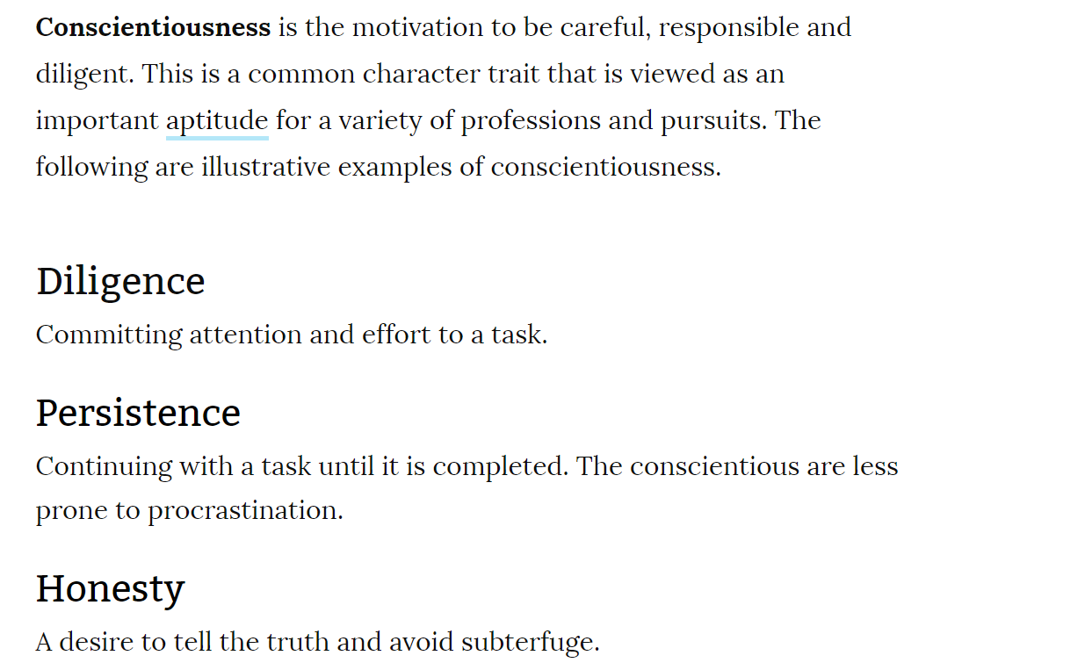

Slide 105
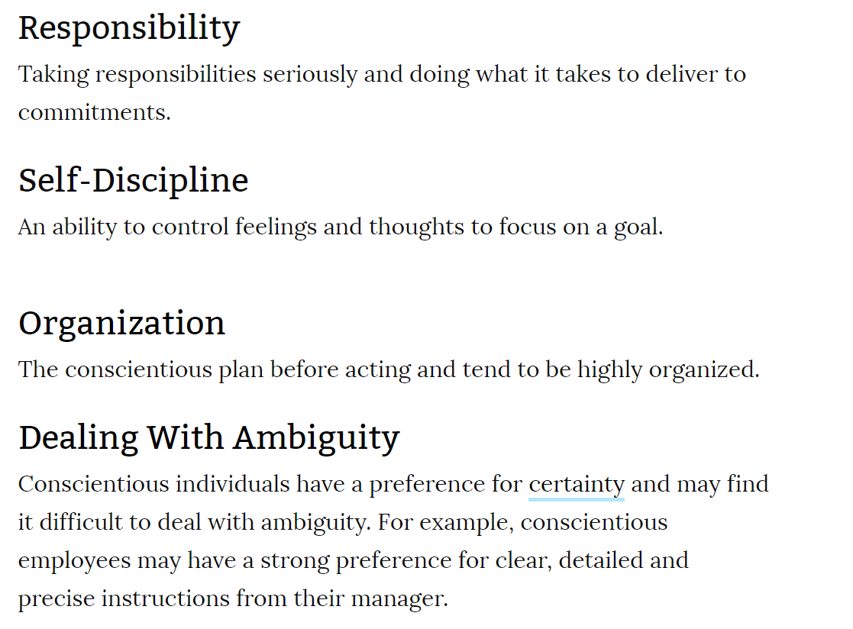

Slide 106
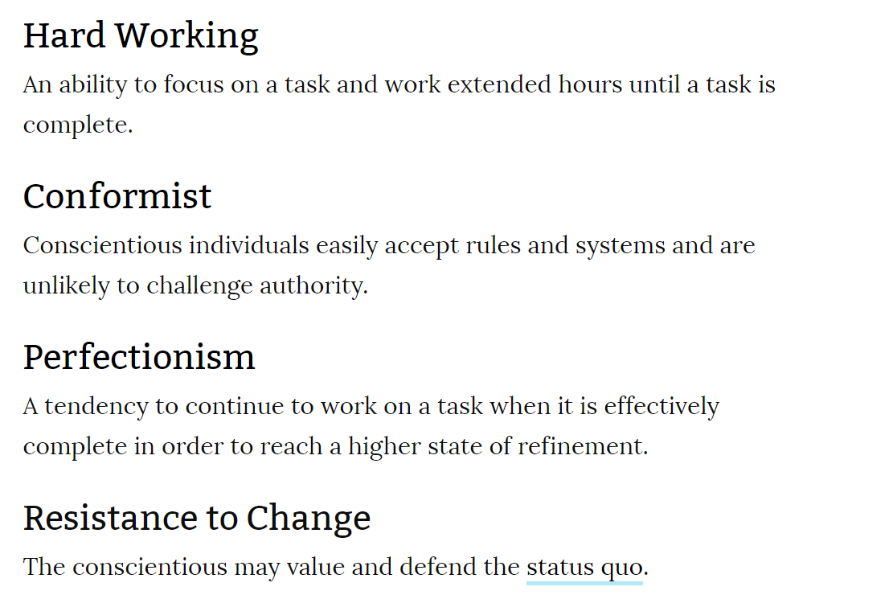

Slide 107
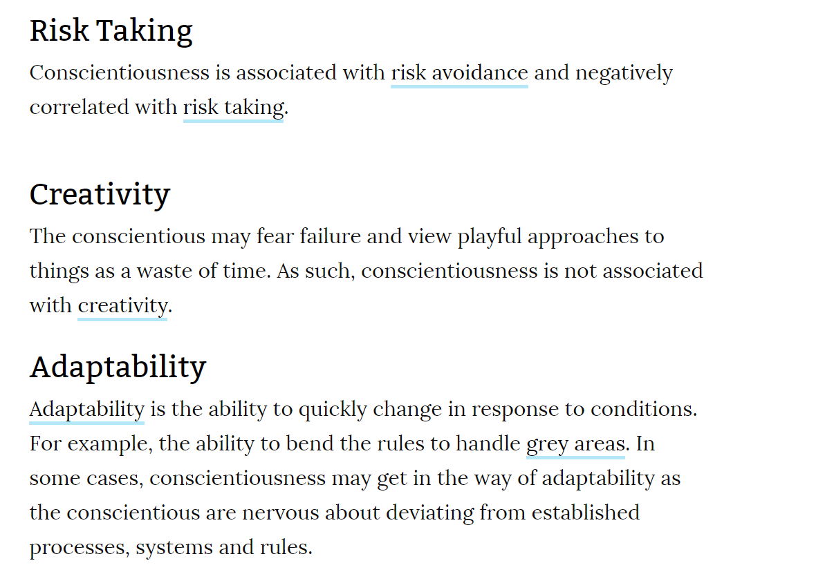

Slide 108
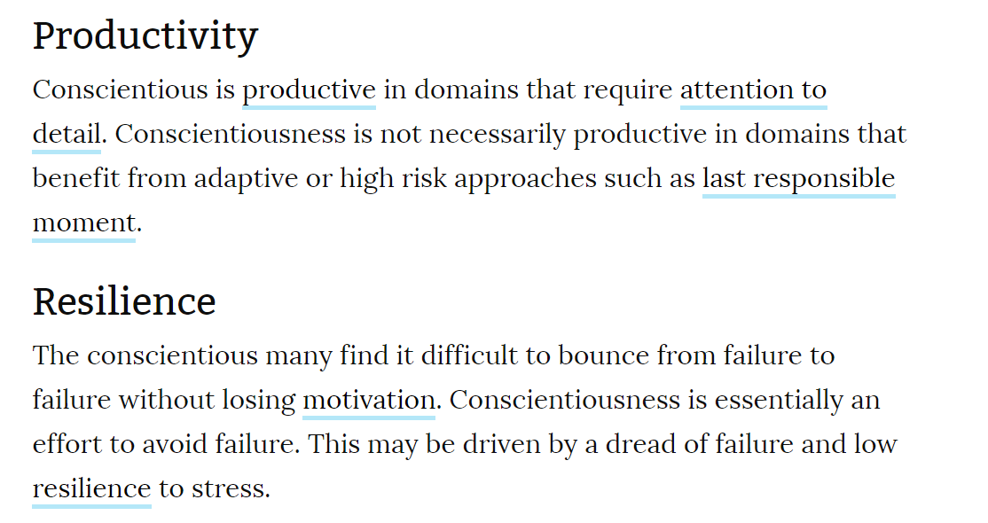
Easily recover from failure

Slide 109
INFORMED CONSENT
As a responsible engineer, one should be informed of the facts so as to be conscious. The engineered products of the company should be in such a way that they can never be used to perform any illegal or unsocial activities, which causes destruction.
It is to be observed that if a company produces some products that are out of fashion or the items which promote wastage of energy and do not fetch in benefits, such things are to be well explained to the employer and alternative solutions should also be suggested by the engineers.

Slide 110
What is informed consent?
Informed consent is when a healthcare provider — like a doctor, nurse, or other healthcare professional — explains a medical treatment to a patient before the patient agrees to it. This type of communication lets the patient ask questions and accept or deny treatment.
In a healthcare setting, the process of informed consent includes:
your ability to make a decision
explanation of information needed to make the decision
your understanding of the medical information
your voluntary decision to get treatment
These components are essential elements of the shared decision-making process between you and your healthcare provider. Most importantly, it empowers you to make educated and informed decisions about your health and medical care.

Slide 111
Moral Autonomy
Any person can be morally autonomous only when one is being genuine in one’s commitment towards moral values.
Moral beliefs and attitudes must be integrated into an individual’s personality which leads to a committed action.
The responsibility to answer an unexpected result, influences an engineer to involve himself personally into the work.
This leads to moral autonomy wherein, he also gains the trust of the employer, through his commitment.
Such responsible actions lead to great outcomes.

Slide 112
Moral Autonomy is the philosophy which is self-governing or self-determining, i.e., acting independently without the influence or distortion of others. The moral autonomy relates to the individual ideas whether right or wrong conduct which is independent of ethical issues. The concept of moral autonomy helps in improving self-determination.
Moral Autonomy is concerned with independent attitude of a person related to moral/ethical issues.
This concept is found in moral, ethical and even in political philosophy.

Slide 113
Moral Autonomy – Skills Needed
Ability to relate the problems with the problems of law, economics and religious principles − It is essential to have the ability to analyze a problem and finding the relation with the existing law or the topic of issue with the existing principles on that topic. The ability to distinguish between both of them and finding the moral reasons.
Skill to process, clarify and understand the arguments against the moral issues − If the issue is against some moral values or the ethical values to be followed in the society, then clarity should be maintained about the differences and similarities. Both of these differences and similarities are to be judged based on why they are a matter of concern and in what aspect.
Ability to suggest the solutions to moral issues on the basis of facts − If the moral issues are not fulfilling and needs to be, then the solutions are to be suggested according to the moral issues based on the facts and truths of the issue. These suggestions must be consistent and must include all the aspects of the problem. No partiality is to be allowed in any such aspect.

Slide 114
Must have the imaginative skill to view the problems from all the viewpoints − After having known about the facts and illusions of the issue, a clear understanding is attained in viewing the problem in all kinds of viewpoints. This enables one to be able to suggest a proper alternative solution.
Tolerance while giving moral judgment, which may cause trouble − When the whole analysis is made considering all the viewpoints of the issue, the final output might be or might not be pleasing to the persons involved. Hence while declaring the judgment or the decisions taken, a detailed description of the actions done should be given, while the actions ought to be done should be presented in a better way, to ensure others that the decisions have been taken without any partialities towards any party.
Tolerance while giving moral judgment, which may cause trouble − When the whole analysis is made considering all the viewpoints of the issue, the final output might be or might not be pleasing to the persons involved. Hence while declaring the judgment or the decisions taken, a detailed description of the actions done should be given, while the actions ought to be done should be presented in a better way, to ensure others that the decisions have been taken without any partialities towards any party.

Slide 115
Accountability
Accountability can be understood as the moral responsibility that we have towards our actions.
It means a tendency to be willing to openly accept the moral examinations towards one’s actions and being responsive to the assessment of others.
The gap between casual responsibility and moral accountability is common in any profession, along with engineering.

Slide 116
Let us now consider the following instances to understand accountability −
When a group of persons are involved in the completion of a project, then the accountability refers to the group minimizing the chances of acceptance of moral responsibility towards a specific action, where each person makes only a small contribution to something much larger.
The accountability is diffused within the organization and one has to accept it. Both credit and failure need to be considered for accountability where the work is diffused and the areas of personal accountability are delimited within the organization.
At times, when the engineers are pressurized to move to another project while the current is still underway, then the accountability is limited only for meeting schedules.
There is always a moral involvement beyond the laid down institutional role, where the engineers cannot separate themselves from personal responsibilities of their work.

Slide 117
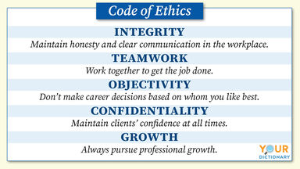
What are the codes of Engineering ethics?
The engineering societies such as IEEE, AICTE have framed some codes of ethics which are helpful to engineers to strengthen the moral issues on their work.
A code of ethics is a set of principles and rules used by individuals and organizations to govern their decision-making process, as well as to distinguish right from wrong. They provide a general idea of the ethical standards of a business or organization. However, people can have their own personal code of ethics as well

Slide 118
Serving and Protecting the Public
Engineers are in a responsible position where trust and trustworthiness, both are essential. A code of ethics functions as a commitment to the profession as a whole that engineers will serve the public health, safety, and welfare. All the remaining ones contribute to this function in some or other way.
Guidance
Codes are written in brief yet effective to offer general guidance to the engineers. More specific directions may be given in supplementary statements or guidelines, which tell how to apply the code. If needed, the assistance is obtained for further specification.
Inspiration
Codes of ethics, which specify a collective commitment towards a profession, helps in motivation for ethical conduct. Actually, these codes make one feel really responsible and proud to be a professional thus motivating towards the commitment one should have towards one’s profession.
Shared Standards
The standards established should be applicable to all individuals, in their particular professions. With the codes of ethics, the public is assured of engineers with a minimum standard of excellence and the professionals are provided a fair way to compete.

Slide 119
Support for Responsible Professionals
The professionals who act ethically have more positive support through these codes. A professional engineer who has the intention to stand by the codes of ethics can have no harm from immoral professional obligations, as he can reject smoothly yet formally. As well, these codes can provide legal support to engineers who are criticized for living up to work-related professional obligations.
Education and Mutual Understanding
The codes which are widely circulated and officially approved by professional societies promote a shared understanding among professionals, the public and government organizations about the moral responsibilities of engineers. These codes prompt discussion and reflection on moral issues

Slide 120
Discipline
The professionals those who fail to follow the codes exhibit unethical conduct, which is evident from the disobedience. Such an investigation generally requires paralegal proceedings designed to get at the truth about a given charge without violating the personal rights of those being investigated.
This might lead to the expulsion of those whose professional conduct has been proven unethical, which also leads to loss of respect from colleagues and the local community.
Contributing to the Profession’s Image
Codes project the engineers as the professionals of an ethically committed profession, which inspires them to work with great commitment and more effectively to serve the public. It can also win greater powers of self-regulation for the profession itself while lessening the demand for more government regulation.

Slide 121
Limitations:
The codes are not remedy for all evils. They have many limitations, namely:
1. General and vague wordings. Many statements are general in nature and hence unable to solve all problems.
2. Not applicable to all situations. Codes are not sacred, and need not be accepted without criticism. Tolerance for criticisms of the codes themselves should be allowed.
. They can not be treated as final moral authority for professional conduct. Codes have flaws by commission and omission. There are still some grey areas undefined by codes. They can not be equated to laws. After all, even laws have loopholes and they invoke creativity in the legal practitioners.

Slide 122
5. Only a few enroll as members in professional society and non-members can not be compelled.
6. Even as members of the professional society, many are unaware of the codes
7. Different societies have different codes. The codes can not be uniform or same! Unifying
codes may not necessarily solve the problems prevailing various professions, but attempts are still made towards this unified codes.
8. Codes are sometimes claimed to be threatening and forceful

Slide 123
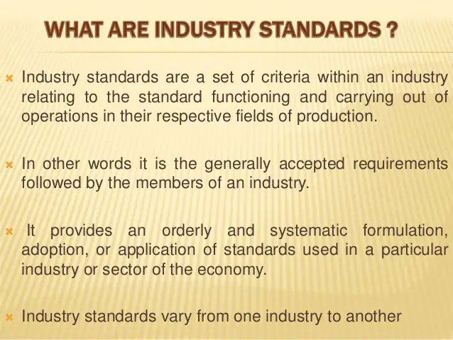

Slide 124
EXAMPLES
Organizations like the American National Standards Institute (ANSI) set standards with input from industry representatives and consumers.
Many national organizations have a connection to an international partner, allowing companies to do things like agreeing on film sizes for cameras so people can buy film anywhere in the world.
Using standard shapes and sizes for equipment components can be beneficial for the manufacturing community, as well as customers by making it easier to produce parts and products.

Slide 125
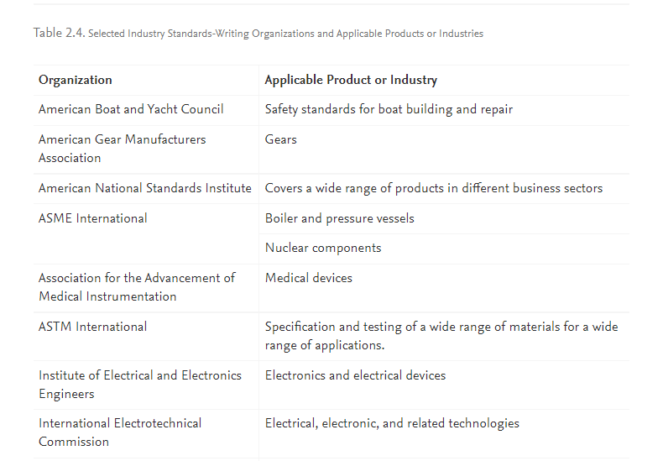

Slide 126
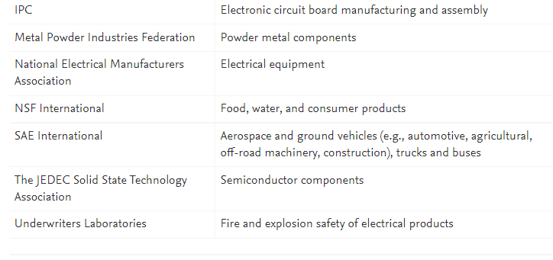

Slide 127
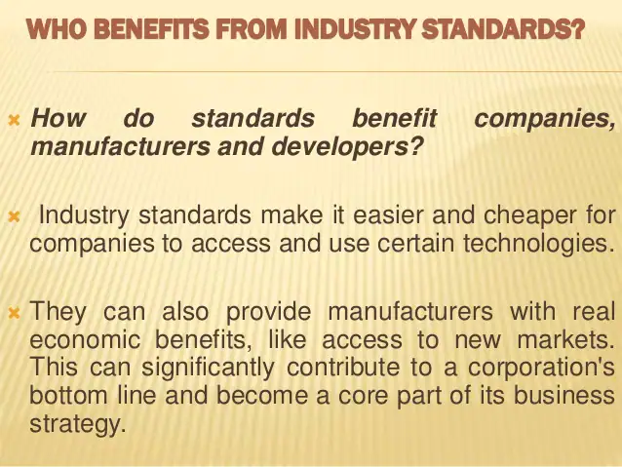

Slide 128
Industrial standards are important for any industry. Specification helps in achieving interchangeability.
Standardization reduces the production costs and at the same time, the quality is achieved easily. It helps the manufacturer, customers and the public, in keeping competitiveness and ensuring quality simultaneously.
Industrial standards are established by the Bureau of Indian Standards, in our country in consultation with leading industries and services.
International standards have become relevant with the development of the world trade. The International Standards Organization has now detailed specifications for generic products/services with procedures that the manufacturers or service providers should follow to assure the quality of their products or service. ISO 9000-2000 series are typical examples in this direction

Slide 129
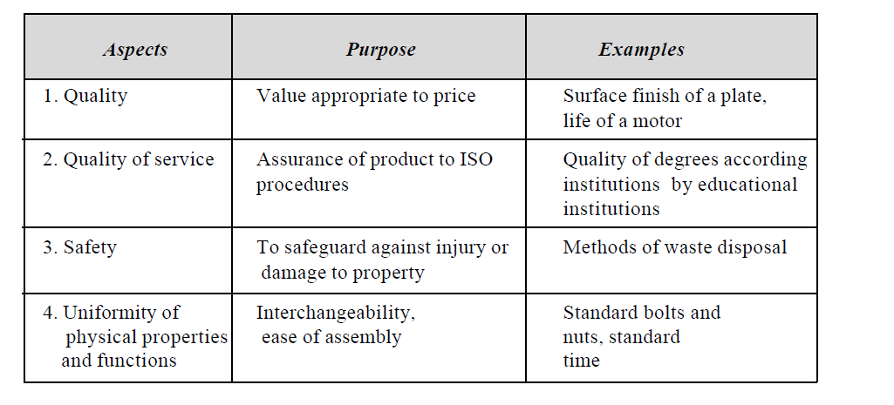
INDUSTRIAL STANDARDS

Slide 130
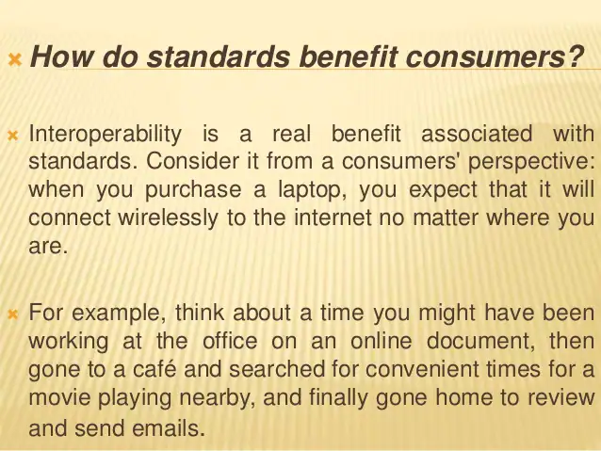

Slide 131
A BALANCED OUTLOOK ON LAW
A balanced outlook of laws emphasizes the necessity of laws and regulations and their limitations in governing engineering practice.
What is Law?
• It is a body of rules of action prescribed by controlling legal authority and having binding legal force
• In general laws means all the rules established by authority or custom for regulating the behavior of members of a community or country.
Relationship between Laws and ethics:
• Ethics- what is ought to do, what is not
• Law – standard behavior required for individual
The law consists of a set of rules and regulations, whereas Ethics comprises of guidelines and principles that inform people about how to live or how to behave in a particular situation.
1969- Santa Barbara (offshore Spril)- 235000gallon crude oil
1758- babylons Building Code
1852 US Steamboat Code

Slide 132
The Code of Hammurabi: The Best Rule To Manage Risk
Hammurabi became ruler of Babylon in 1792 BC and held the position for 43 years. In the era of city-states, Hammurabi grew his modest kingdom (somewhere between 60 and 160 square kilometers) by conquering several neighboring states. Satisfied, then, with the size of the area he controlled, Hammurabi settled down to rule his people.
Almost 4,000 years ago, King Hammurabi of Babylon, Mesopotamia, laid out one of the first sets of laws.
Hammurabi’s Code is among the oldest translatable writings. It consists of 282 laws, most concerning punishment.
Each law takes into account the culprit’s status.
The code also includes the earliest known construction laws, designed to align the incentives of builder and occupant to ensure that builders created safe homes.

Slide 133
229.If a builder builds a house for a man and does not make its construction firm, and the house which he has built collapses and causes the death of the owner of the house, that builder shall be put to death.
230.If it causes the death of the son of the owner of the house, they shall put to death a son of that builder.
231.If it causes the death of a slave of the owner of the house, he shall give to the owner of the house a slave of equal value.
232.If it destroys property, he shall restore whatever it destroyed, and because he did not make the house which he builds firm and it collapsed, he shall rebuild the house which collapsed at his own expense.
233.If a builder builds a house for a man and does not make its construction meet the requirements and a wall falls in, that builder shall strengthen the wall at his own expense.
This code was expected to put in self-regulation seriously in those years.

Slide 134
Steam Boat Code in USA
The steam engines used for travel during those days were really heavy and bulky. James Watt who invented steam engine worked with two more scientists Oliver Evans and Richard Trevithick who had modified the old steam engines by removing condensers and made them compact.
These redesigned engines though made lighter, couldn’t solve the problem of boiler explosions. The speed of the boats if increased led to the explosion of the boilers on steam boats causing disasters.
Then Alfred Guthrie, an engineer of Illinois had inspected around 200 steam boats with his own funding and found out the reasons for the boiler explosions and later prepared a report relating to the care that could be taken later.
The recommendations made by him were published by Senator Shields of Illinois and incorporated in senate documents which later was made a law, which made the mechanical engineers of America (ASME), to formulate the standards in the manufacturing of steam boats.

Slide 135
Congress responded to these maritime disasters by establishing precise standards for steamboat boiler construction, including rules about safety valves and operating pressures.
It also set up a licensing system for all operators of passenger steamboats. Licensing came under the purview of the U.S. Department of Treasury, which hired civilian inspectors. The Steamboat Act of 1852 was the basis for the U.S. Steamboat Inspection Service.

Slide 136
1969 Santa Barbara oil spill
The Santa Barbara oil spill occurred in January and February 1969 in the Santa Barbara Channel, near the city of Santa Barbara in Southern California. It was the largest oil spill in United States waters by that time, and now ranks third after the 2010 Deepwater Horizon and 1989 Exxon Valdez spills. It remains the largest oil spill to have occurred in the waters off California.
The source of the spill was a blow-out on January 28, 1969, 6 miles (10 km) from the coast on Union Oil's Platform A in the Dos Cuadras Offshore Oil Field. Within a ten-day period, an estimated 80,000 to 100,000 barrels (13,000 to 16,000 m³)^{[1]} of crude oil spilled into the Channel and onto the beaches of Santa Barbara County in Southern California, fouling the coastline from Goleta to Ventura as well as the northern shores of the four northern Channel Islands.
The spill had a significant impact on marine life in the Channel, killing an estimated 3,500 sea birds,^{[2]} as well as marine animals such as dolphins, elephant seals, and sea lions. The public outrage engendered by the spill, which received prominent media coverage in the United States, resulted in numerous pieces of environmental legislation within the next several years, legislation that forms the legal and regulatory framework for the modern environmental movement in the U.S

Slide 137
Proper Role of Laws
Good laws when enforced effectively produce benefits. They establish minimal standards of professional conduct and provide a motivation to people. Further they serve as moral support and defense for the people who are willing to act ethically.
Thus, it is concluded that:
1. The rules which govern engineering practice should be construed as of responsible experimentation rather than rules of a game. This makes the engineer responsible for the safe conduct of the experiment.
2. Precise rules and sanctions are suitable in case of ethical misconduct that involves the violation of established engineering procedures, which are aimed at the safety and the welfare of the public.
3. In situations where the experimentation is large and time consuming, the rules must not try to cover all possible outcomes, and they should not compel the engineers to follow rigid courses of action.
4. The regulation should be broad, but make engineers accountable for their decisions, and
5. Through their professional societies, the engineers can facilitate framing the rules, amend wherever necessary, and enforce them, but without giving-in for conflicts of interest.

Slide 138
CASE STUDY: THE CHALLENGER
What happened?
The orbiter of the Challenger had three main engines fuelled by liquid hydrogen. The fuel was carried in an external fuel tank which was jettisoned when empty. During lift-off, the main engines fire for about nine minutes, although initially the thrust was provided by the two booster rockets. These booster rockets are of the solid fuel type, each burning a million pound load of aluminum, potassium chloride, and iron oxide.
The casing of each booster rocket is about 150 feet long and 12 feet in diameter. This consists of cylindrical segments that aconsisting of pairs of O-rings made of vulcanized rubber. The O-rings work with a putty barrier made of zinc chromate.
The engineers were employed with Rockwell International (manufacturers for the orbiter and main rocket), Morton-Thiokol (maker of booster rockets), and they worked for NASA. After many postponements, the launch of Challenger was set for morning of Jan 28, 1986. Allan J. McDonald was an engineer from Morton-Thiokol and the director of the Solid Rocket Booster Project. He was skeptic about the freezing temperature conditions forecast for that morning, which was lower than the previous launch conditions. A teleconference between NASA engineers and MT engineers was arranged by Allan.re assembled at the launch site. There are four-field joints and they use seals
Arnold Thompson and Roger Boisjoly, the seal experts at MT explained to the other engineers how the booster rocket walls would bulge upon launch and combustion gases can blow past the O-rings of the field joints

Slide 139
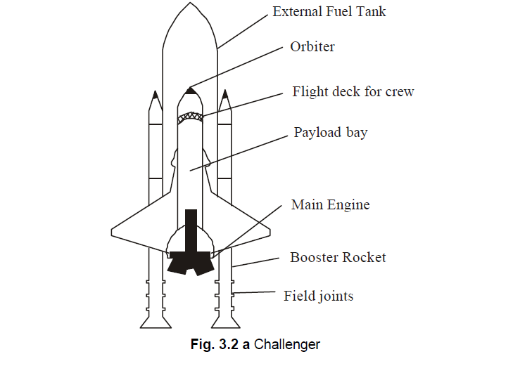

Slide 140
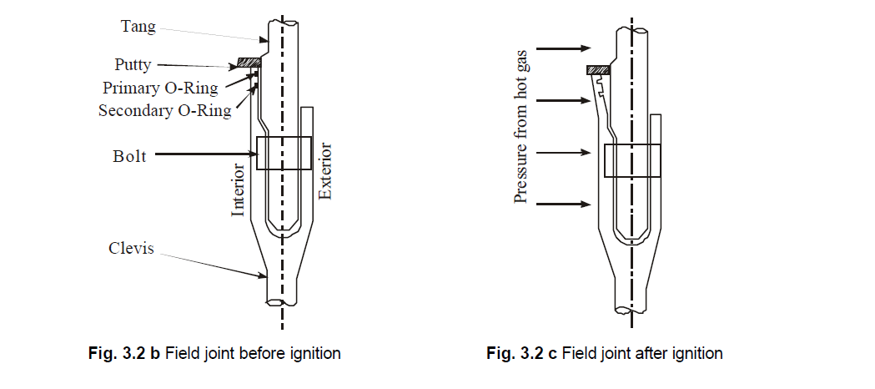

Slide 141
On many of the previous flights the rings have been found to have charred and eroded. In freezing temperature, the rings and the putty packing are less pliable. From the past data gathered, at temperature less than 65 °F the O-rings failure was certain. But these data were not deliberated at that conference as the launch time was fast approaching.
The engineering managers Bob Lund and Joe Kilminster agreed that there was a safety problem. Boisjoly testified and recommended that no launch should be attempted with temperature less than 53 °F. These managers were annoyed to postpone the launch yet again. The top management of MT was planning for the renewal of contract with NASA, for making booster rocket. The managers told Bob Lund “to take-off the engineering hat and put on your management hat”. The judgment of the engineers was not given weightage. The inability of these engineers to substantiate that the launch would be unsafe was taken by NASA as an approval by Rockwell to launch.
At 11.38 a.m. the rockets along with Challenger rose up the sky. The cameras recorded smoke coming out of one of the filed joints on the right booster rocket. Soon there was a flame that hit the external fuel tank. At 76 seconds into the flight, the Challenger at a height of 10 miles was totally engulfed in a fireball. The crew cabin fell into the ocean killing all the seven aboard.
Some of the factual issues, conceptual issues and moral/normative issues in the space shuttle challenger incident, are highlighted hereunder for further study.

Slide 142
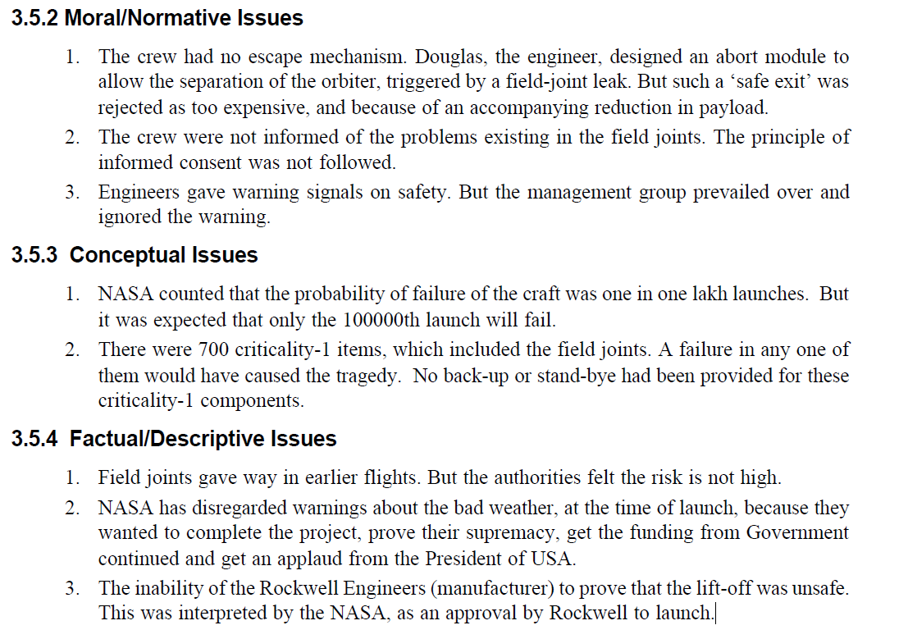

Slide 143
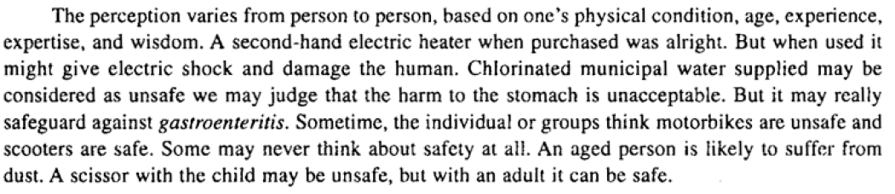
Safety and Risk
The terms of safety and risk are inter-related.
According to William W Lowrance, the famous consultant of those times, Safety was defined as “A thing is safe if its risks are judged to be acceptable.

Slide 144
Different methods are available to determine the risk (testing for safety)
1. Testing on the functions of the safety-system components.
2. Destructive testing: In this approach, testing is done till the component fails. It is too expensive,
but very realistic and useful.
3. Prototype testing: In this approach, the testing is done on a proportional scale model with all
vital components fixed in the system. Dimensional analysis could be used to project the
results at the actual conditions.
4. Simulation testing: With the help of computer, the simulations are done. The safe boundary
may be obtained. The effects of some controlled input variables on the outcomes can be
predicted in a better way.
Destructive testing is undertaken in order to understand a specimen’s performance or material behaviour, these procedures are carried out to the test specimen’s failure.
To help engineering teams assess the "buildability" of their project concept, they often create prototypes. A prototype is a working model of a product that is used for testing before it is manufactured. ... A prototype is used to test different working aspects of a product before the design is finalized.
Simulation tests are used to assess how you would react to situations you can encounter while working and how you would solve problems. ... They are one of the most used psychometric tests because the employer gets a good insight into your attitudes, ability to solve problems, and how you handle real-life situations.

Slide 145
Acceptability of Risk
Lowrance in his definition observed safety as acceptable risk. Let us relate to this and further see the definition by William D. Rowe, “a risk is acceptable when those affected are generally no longer apprehensive about it”.
Influential factors that lead to such apprehension are −
Whether the risk is accepted voluntarily.
The effects of knowledge on how the probabilities of harm (or benefit) are known or perceived.
If the risks are job-related or other pressures exist that cause people to be aware of or to overlook risks.
Whether the effects of a risky activity or situation are immediately noticeable or are close at hand.
Whether the potential victims are identifiable beforehand.
The acceptability of risk depends upon the types of risks such as voluntary and involuntary risks, short term and long term consequences, expected probability, reversible effects, threshold levels for risk, delayed and immediate risk, etc.
Voluntarism and Control
In our daily life, we come across many such things where the scopes of risk might or might not be low. The person who breaks a red signal, is prone to be a victim of an accident, but risks. A person who lives near a dumping yard is prone to ill-health, but neglects. A boy who rides a vehicle at a high speed cannot rely on the perfect functioning of the brakes. But these people take voluntary risks thinking they can control.

Slide 146
Effective information on Risk assessment
The acceptance of risks also depends on the manner in which information necessary for decision making is presented. A person can be motivated to violate the safety rules by explaining the higher probability of success, whereas the same person can be demotivated from such task, by explaining the probability of failure and the fatal effects of it.
Job-related Risks
In some jobs where the workers are exposed to chemicals, radiations and poisonous gases etc., they are not informed about the probable risks the workers would be facing, in doing their jobs. These are such dangers where the toxic environments cannot readily be seen, smelled, heard or sensed otherwise.
Magnitude and Proximity
It is unfortunate that most of us, realize the magnitude of risk only when we ourselves or the person who is in our close proximity or a relative, gets affected. A group of 20 friends including us, if gets affected or if had a narrow escape from death, affects us more than the incident occurred to a group of 50 strangers, in a group of a 1000. This proximity effect arises in perceptions of risk over time as well.

Slide 147
Risk Analysis
The study of risk analysis covers other areas such as risk identification, risk analysis, risk assessment, risk rating, suggestions on risk control and risk mitigation. In fact, risk analysis can be deeply discussed with a view on risk management study. The risk management study also includes residual risk transfer, risk financing, etc.
A step-wise risk analysis includes −
Hazards identification
Failure modes and frequencies evaluation from established sources and best practices.
Selection of credible scenarios and risks.
Fault and event trees for various scenarios.
Consequences-effect calculations with work out from models.
Individual and societal risks.
ISO risk contours superimposed on layouts for various scenarios.
Probability and frequency analysis.
Established risk criteria of countries, bodies, standards.
Comparison of risk against defined risk criteria.
Identification of risk beyond the location boundary, if any.
Risk mitigation measures.
All of these again depend on how the risk is compared with the benefit in doing the work with some risk. How far it is beneficial to risk also counts the actions of a person while coming out of the safety bounds.

Slide 148
4.2.1 Analytical Methods
Several analytical methods are adopted in testing for safety of a product/project.
1. Scenario Analysis
This is the most common method of analysis. Starting from an event, different consequences are
studied. This is more a qualitative method.
For example, a disaster recovery plan, for an organization is discussed. When the probability and
size of loss (indicating possibility and financial significance, respectively) are both high, risk exists.
On the other hand, risk is not associated with very low probability of occurrence, or with losses that
under any other circumstances would be considered “affordable”. But there is a gray area between
probability/loss combinations that are truly risky, and those that are not. This reflects the fact that the
boundary between risky and non-risky events is fuzzy, not exact.
To assess the risk faced by the organization, the planner matches the probability and loss
characteristics of various exposures to one’s intuition of risk. This exposure analysis can be most
effectively carried out using ‘loss scenarios’. A scenario is a synopsis of events or conditions leading to
an accident and subsequent loss. Scenarios may be specified informally, in the form of narrative, or
formally using diagrams and flow charts.
Steps for

Slide 149
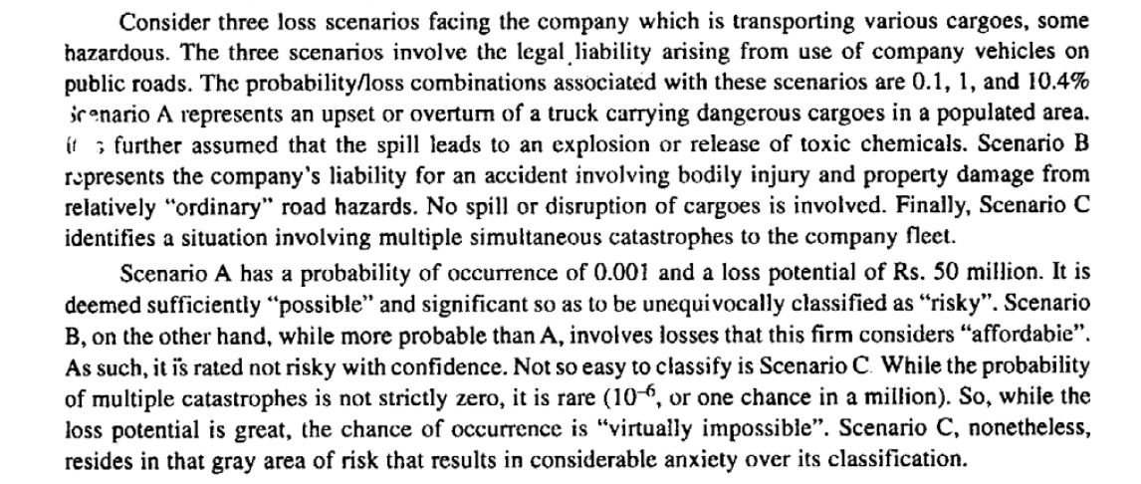

Slide 150
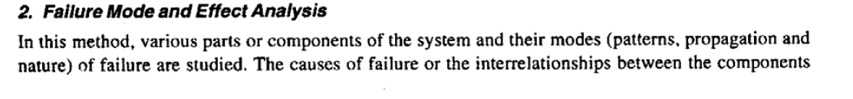
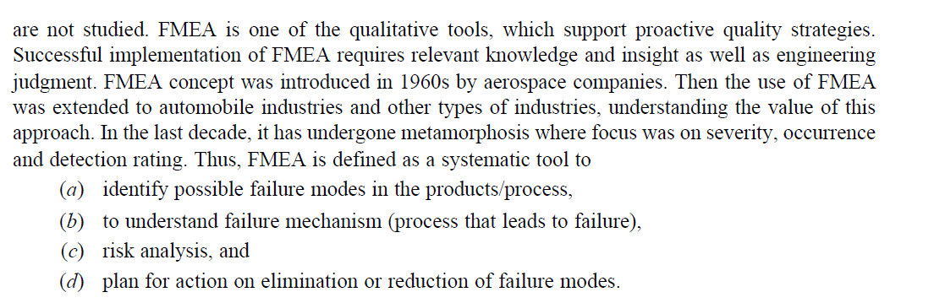

Slide 151
A. STEPS TO CONDUCT FMEA
FMEA is a cross-functional team management. Throughout the product development cycles,
changes and updates will be introduced to the product and process. These changes have to be reviewed
because they can introduce new risks or failure modes. It is thus necessary to review and update
changes.
1. Product/process and its function must be understood first. This is the most fundamental
concept to be adopted in this methodology. This understanding helps the engineer to identify
product/process function that fall with the intended and unintended users.
2. Block diagram of product/process is created and developed. The diagram shows the major
components or process steps as blocks, identifies their relations namely, input, function and
output of the design. The diagram shows logical relationship of components and establishes
a structure for FMEA. The block diagram should always be included in the FMEA form.
3. Header on FMEA form is completed. FMEA form includes part/process name, model date,
revision date, and responsibility.
4. The items/functions are listed logically in the FMEA form, based on the block diagram

Slide 152
5. Then failure modes are identified. A failure mode is defined wherein a component, subsystem,
system, and process could potentially fail to meet the design intent.
6. A failure mode in one component can cause failure in another. Each failure should be listed
in echnical terms. Listing should be done component- or process-wise.
7. Then the effects of each risk/failure mode are described. This is done as perceived by both
internal and external customers. The examples of risk/failure effect may include injury to
the user, environment, equipment, and degraded performance. Then a numerical ranking is
assigned to each risk or failure. It depends upon the severity of the effect. Commonly, in the
scale, No.1 is used to represent no effect and 10 to indicate very severe failure, affecting
system of operation and user. By this, the failures can be prioritized and real critical risks
can be addressed first.
8. Then the causes of each failure mode have to be identified. A cause is defined as a design
weakness that results in a failure. The potential causes for each failure mode are identified.
The potential causes, for example, may be improper torque or contamination or excessive
loading or external vibration

Slide 153
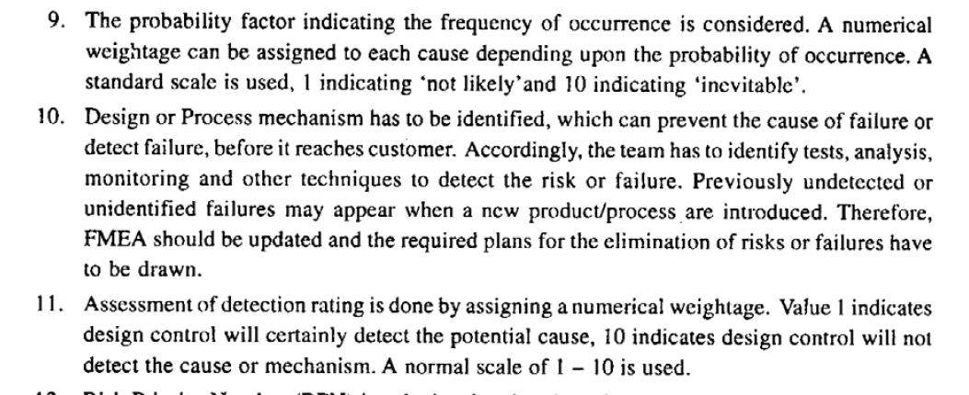

Slide 154
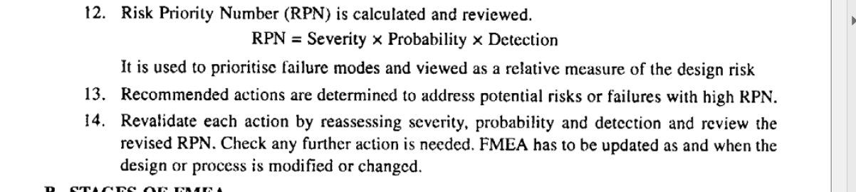

Slide 155
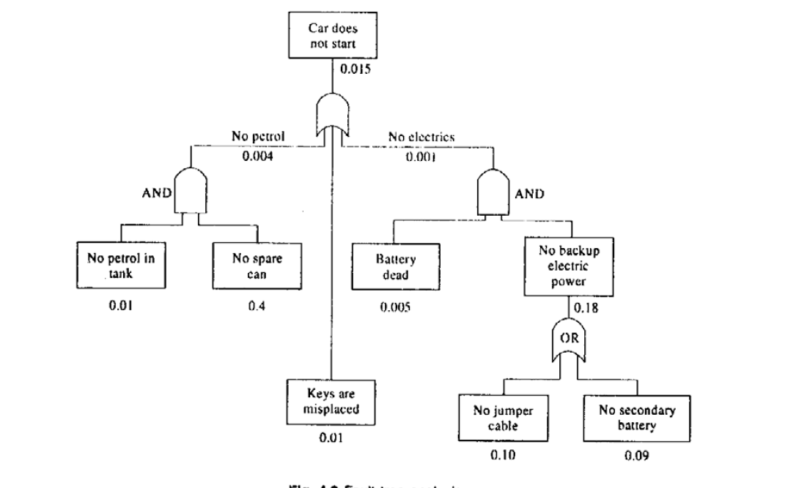
Fault-tree Analysis
This is a qualitative method and was originated by Bell Telephones. It is technology-based deductive logic. The failure (undesirable event) is initially defined, and the events (causal relationships) leading to that failure are identified at different components level. This method can combine hardware failures and human failures
Example 3: An automobile car does not start. The details of this case are shown in Fig.

Slide 156


Event tree analysis provides a model for examining the possible outcomes from a single event.

Slide 157


Slide 158


Slide 159


Slide 160



Slide 161


Slide 162
4.11 Risk Benefit Analysis
It is technique, used to analyze the risk in project and to determine whether the project should be carried out or not
It answers the following questions
  What are the benefits of product/project?
  Is the project is worth for the risk?
  Do benefits balance the risk?
Everyone is ready to accept certain level of risks

Slide 163
Conceptual difficulties in Risk-Benefit Analysis
Both risks and benefits very difficult to calculate because lie in future (uncertainties)
Ensure who takes risk are to be enjoy benefit
It is difficult to express both risk and benefits is a common set of units.

Slide 164
Ethical implications on Risk- Benefit Analysis
While performing Risk –benefit analysis, one should keep in mind the following ethical questions:
  Under what condition, someone in society is entitled to impose a risk in someone else on behalf of supposed benefit to others?
  How can we consider the worst case scenarios of persons exposed to maximum risks while they are obtaining only minimum benefits?
  Are their rights violated?
  Are they provided safer alternatives?

Slide 165
Personal Risk
If sufficient information is given to a person, he can able to decide whether to participate in a risky activity or not.
Many experiments concluded- individuals are willing to face voluntary risks than involuntary risks
They are difficult to assess
Examples:
  A person living near chemical plant
  A Person working in nuclear plant

Slide 166
Assessing personal risk
Answer following ethical questions
  How to access the money value of an individuals life?
  On what basis, the compensation for a risk can be decided?
  Is the compensation is justifiable?
  What will be the compensation if the tolerance level is above the tolerance level?

Slide 167
Minimize the difficulties in personal risk
Life insurance
Increased wages

Slide 168
Public Risk and public acceptance
Public Risk can be easily determine than personal Risk
Assessment studies related to technological safety can be conducted for public risk
According to National Highways Traffic safety Administration(NHTSA) has emphasized following two points
  A value of human life can be estimated based on loss of future income and other costs associated with an accident
  A estimate of quantifiable losses in social welfare is not based on maximum expenditure allocated to save a life

Slide 169
Accounting publicly for Benefits and Risks
Public accountability for risk has been affected by the following problems
  An expert or even group of experts cant be expected to know everything
  The uncertainties produced by scientist and regulators* also infects the risk regulation
  Since the origins of risk vary depending on how the facts are presented, therefore special cause should be given when starting probabilities if rare events
  (*regulator- who assure the public that there are no risk, but they know that the answer are not at hand)

Slide 170
Becoming responsible engineers regarding risks
Engineer can provide background material to prove the faulty positions
Engineers should actively participate in debates related to safety and risks
Engineers should always insist on meaningful numbers and figures when assessing safety and risk
Engineers should also recognize previously mentioned difficulties with measuring risk and benefits
Engineers should not be influenced by any influential lobby or trade organization
Engineers need to sensitive to various quantitative value judgement related with human and ethical values
Engineers should be aware at the legal liabilities regarding risk.

Slide 171
Reducing Risk
It is impossible to design and manufacture anything to be completely risk free
Engineers responsibility to explore all the possible ways to reduce the risk under the given financial and time constraint
Risk Management: Eradication or minimization of the adverse effects of the pure risks to which an organization is exposed
Elements of Risk management Programme:
  Risk identification
  Risk Evaluation( Risk measurement)
  Risk Control

Slide 172
Elements of Risk Management
Risk Identification
  Risk can be identified by various techniques such as physical inspection, safety audit, job-safety analysis, management and worker discussions,& historical data analysis
Risk Evaluation
  Risk can be evaluated on the basis of economic, social or legal considerations
  Economic and social considerations include financial aspects, uninsured cost of accidents, insurance premium, overall effect of profitability, possible loss of production
  Legal considerations include possible health and safety law, code of practice, guidance notes & accepted standards, fire prevention, pollution and product liability

Slide 173
Elements of Risk Management
Risk Control
  Risk control consists of 4 areas
Risk Avoidance
  It refers to the conscious decision by the management to avoid completely a particular risk by discontinuing the operation producing risk
Risk retention
  Retaining a particular risk for which any consequent loss is financed by organization
Risk transfer
  Legal assignment of cost of certain potential losses from one party to another (insurance)
Risk reduction
  Reduction or elimination of all aspect of accidental loss lead to wastage of an organizations assets.

Slide 174
Three approaches to acceptable risk
The Experts Approach
The Layperson’s Approach
The Government Regulator’s Approach

Slide 175
Experts Approach to Acceptable Risk
Identifying risk:
Utilitarianism and acceptable risk
Risk as maximizing benefit

Slide 176
Identifying risk
concept of risk involves adverse effect or harm. Harm is a limitation of a persons freedom or well being. (physical well being, psychological well being, economical well being)
Risk can be defined as: “a compound measure of the probability and magnitude of adverse effect” (William W. Lowrance)
We can add : “probability of death or injury”

Slide 177
Utilitarianism and Acceptable risk
The experts approach to risk is usually utilitarian. That the answer to any moral question is to be found by determining the course of action that maximizes well being.
Cost/benefit technique is often called risk/benefit analysis. Cost is measured in terms of risk of deaths, injuries, or other harms associated with a given course of action.
* Utilitarian - Practical

Slide 178
Risk as maximizing benefit
An acceptable risk is one of where , given the options available, the risk of harm is at least equaled by the probability of producing benefit.
Limitations: (that will yield the cost/benefit approach inconclusive)
It might not be possible to anticipate all of the costs and benefits associated with each option
It is not always possible to translate all of the risks and benefits into monetary terms. What is the monetary value of human life?
The method makes no allowances for the distributions of costs and benefits.
The method gives no place for informed consent to the risk imposed by technology.

Slide 179
The Laypersons Approach to Acceptable Risk
Expert and Layperson
Public is sometimes mistaken in estimating the probability of death and injury from various activities of technology. Experts and lay person understand risk differently.
Informed consent and justice: lay person approach follows more closely the ethics of respect of persons than utilitarianism.

Slide 180
Free and informed consent and compensation
Three necessities to give free and informed consent to the risks imposed by technology:
A person must not be forced
A person must have the relative information
A person must be rational and competent enough to evaluate the information.

Slide 181
Lay criterion of acceptable risk:
An acceptable risk is one in which risk is freely assumed by free and informed consent, or properly compensated, and which is justly distributed.

Slide 182
The Government Regulator’s Approach to Risk
An acceptable risk is one in which protecting the public from harm has been weighted more heavily than benefiting the public.

Slide 183
Three approaches to acceptable risk
Risk Expert: wants to balance risk and benefit in a way that optimizes overall public well-being.
Layperson: wants to protect himself or herself from risk.
The government regulator: wants as much assurance as possible that the public is not being exposed to unexpected harm.

Slide 184
Becoming a Responsible Engineer Regarding Risk
Includes to be aware
that risk is often difficult to estimate
that there are different approaches to the determination of acceptable risk
of the legal liabilities regarding risk.

Slide 185
(A more general) Principle of Acceptable Risk
People should be protected from the harmful effects of technology, especially when the harms are not consented to or when they are unjustly distributed, accept that this protection must sometimes be balanced against (1) the need to preserve great and irreplaceable benefits and (2) the limitations on our ability to obtain informed consent.

Slide 186
Bhopal Gas Tragedy
On December 3, 1984, Union Carbide's pesticide-manufacturing plant in Bhopal, India leaked 40 tons of the deadly gas, methyl isocyanate into a sleeping, impoverished community - killing 2,500 within a few days, 10000 permanently disabled and injuring 100,000 people. Ten years later, it increased to 4000 to 7000 deaths and injuries to 600,000.

Slide 187
Risks taken:
Storage tank of Methyl Isocyanate gas was filled to more than 75% capacity as against Union Carbide‟s spec. that it should never be more than 60% full.
The company‟s West Virginia plant was controlling the safety systems and detected leakages thro‟ computers but the Bhopal plant only used manual labour for control and leak detection.
The Methyl Isocyanate gas, being highly concentrated, burns parts of body with which it comes into contact, even blinding eyes and destroying lungs.

Slide 188
Causal Factors:
Three protective systems out of service
Plant was understaffed due to costs.
Very high inventory of MIC, an extremely toxic material.
The accident occurred in the early morning.
Most of the people killed lived in a shanty (poorly built) town located very close to the plant fence.

Slide 189
Unit IV
Responsibilities of Engineers
  Collegiality and Loyalty
  Respect for Authority
  Collective Bargaining
  Confidentiality
  Conflicts of Interest
  Occupational Crime
Rights of Engineers
  Professional Rights
  Employee Rights
  Intellectual Property Rights (IPR)
  Discrimination

Slide 190

Responsibilities of Engineers
Internal Responsibilities:
Responsibilities of an engineer towards an employer, that the Responsibilities
within an organization
External Responsibilities :
Responsibilities of an engineer towards outside world, that the Responsibilities
outside organization

Slide 191
Collegiality
It is the tendency to support and cooperate with the colleagues
According to NSPE , the collegiality should include following characteristics
  Engineers should not attempt to injure, unkindly or falsely directly or indirectly, the professional reputation, prospects, practice or employment of other engineers
  Engineers should not untruthfully criticize other engineer’s work.
  Engineers should bring unethical or illegal practice of other engineers to the proper authority for action

Slide 192
Collegiality
According to Craig Ihara – “A kind of connectedness grounded in respect for professional expertise and in commitment to the goals and values of the profession
Elements of Collegiality
  Respect
  Commitment
  Connectedness

Slide 193
Elements of Collegiality
Respect:
  In general Means valuing one’s colleague for their professional skill and their devotion to the social goods promoted by the profession
  For engineering : It means affirming the worth of other engineers engaged in producing socially useful and safe products
  Collegial respect Vs Friendship:
    Collegial respect is Reciprocal like friendship
    But not necessarily develops personal affection like friendship

Slide 194
Elements of Collegiality
Commitment:
  Sharing devotion to the moral ideals essential in the practice of engineering
  Even when there is cut-throat competition b/w engineers, there should be a feeling that all engineers share a concern for overall good to the society

Slide 195
Elements of Collegiality
Connectedness:
  Awareness of being part of a cooperative undertaking created by sharing commitments and skill
  It means the sense of utility among engineers that includes cooperation and mutual support

Slide 196
Why is collegiality a virtue
Collegiality should be encouraged among engineers and other professionals because
  From the point of view of society, collegiality is the influential value to promote the aims of professions.
  It supports personal efforts act responsibly in concert with colleagues
  It strengthen ones motivation to live up to professional standards
  From the point of professionals, collegiality is more valuable as many individuals jointly working for the goodness of the public and society

Slide 197
Negative aspects of collegiality
Collegiality may be misused and distorted.
  Ex: colleagues appeal to be silent about corporate corruption
It may degenerate more group of self-interest, rather than shared devotion to the public
Because of heavy competitions among engineers, collegiality may focus on the corporate goal of maximizing profit at the expense of public good

Slide 198
Loyality
The quality of being true and faithful in one’s support
It is more a function of attitudes, emotions and a sense of identity
Senses of loyalty
  Agency Loyalty
  Identification Loyalty

Slide 199
Agency Loyalty
It is fulfill one’s prescribed duties to an employer
The contractual duties may include particular task for which one is paid, general activities of cooperating with colleagues, and following lawful authority with the organization
It concerns with the matter of actions, whatever it motives. It is motivated by identification with the group to which one is loyal.
Example:
  People may not like the job they do hate their employer, but still they would perform their duty as long as they are employees. This sense of loyalty is agency loyalty

Slide 200
Identification loyalty
It is much concerned with attitudes, emotions, and a sense of personal identity as it does with action
Employee should meet his moral duties to the organization willingly with personal attachment and affirmation.
Some of the duties of loyal employees are,
  To avoid conflicts of interest
  To protect confidential information
  To be honest in making estimates
  To admit one’s error

Slide 201
Is loyalty obligatory(responsibility)
Agency loyalty to employers is an obligation within proper limits
According to john H.Fielder, identification of loyalty is obligatory, only when the two conditions are meet.
  Employees must be treated fairly, they should be given their share of benefits and burdens
  Employees must see that their goals are achieved by and through a group in which they participate
  Identification loyalty is reciprocal in nature. That is employees can be expected to be loyal to employers only when employers show strong commitments to them

Slide 202
Professionalism and Loyalty
Acting on professional commitments to the public is more effective to serve a company than just following company orders.
Loyalty to employers may not mean obeying one’s immediate supervisor.
Professional obligations to both an employer and to the public might strengthen rather than contradict each other.

Slide 203
Respect for Authority
It is right to make decisions, the right to direct the work, and the right to give orders.
It is crucial factor in organization, since engineers and employees must be authorized to carryout the jobs assigned to them.
Authority can be defined as the legal right to command action by others to enforce compliance
Clear lines of authority identifies areas of personal responsibility and accountability.

Slide 204
Sources of authority
Authority derives from the several sources. They are the persons position or rank, and personal attitudes such as charisma, knowledge and expertise

Slide 205
Institutional authority
  It can be defined as the institutional right given to a person to exercise power based on the resource of institution
  It is an authority given by institution to the qualified individuals to meet their industries objectives
  This authority is exercised by making policy, allocating resources, issuing orders, carrying out actions, giving recommendations etc..
  Limitations:
    It is given by owners. In practice sometime, it is given to ineffective persons. They are unable to exercise their authorities effectively in order to meet company’s objectives.

Slide 206
Experts Authority
It is the possession of special knowledge skill, competencies to perform some task or to give sound advice.
It proved that leaders with expertise can be more effectively guide and motivate others than the conventional leaders. This concept is referred as “authority of leadership”
In todays organization, the staff engineers, advisors, and consultants are given expert authority, while the institutional authority is assigned to the line managers

Slide 207
Authority Vs Power
Sl.no | Authority | Power
1 | It is the legal rights to superior, which compel his subordinates to perform certain acts | It is the ability of the person to influence others to perform an act. It may not have legal sanction
2 | It is delegated to an individual by his supervisor | It is earned by an individual through his own efforts
3 | It is mostly well defined and finite | It is undefined and infinite
4 | It lies in the position held and the authority change in position | It resets in the individual. Even when the position has changed, his power remains with him

Slide 208
Morally Justified authority
the institutional authority assigned to employee may ensure in achieving the institutional objectives. But those institutional rights should necessarily be morally justified institutional rights and duties
The institutional authority is said to be morally justified when:
  The goals of the institution are morally permissible or morally desirable
  The way of implementation should not violate basic moral duties.

Slide 209
Accepting authority
Employees accept their employers authority by accepting the guidance and obeying the directives issued by the employer.
According to Herbert Simon, “ a subordinate is said to accept authority whenever he permits his behavior to be guided by the decision of superior, without independently examining the merits of that decision”
All he employers have the limits on ‘zone of acceptance’ in which they are willing to accept the authority
Generally employees are not interested to make an issue of every incident of questionable morality, because of fear of losing their job.
Therfore the ‘zone of acceptance’ can be used as a measure of the lack of individual moral integrity

Slide 210
Paramount Obligations
The engineers paramount obligation is to protect the public health, safety, and welfare, rather than the obligations of loyalty and faithful service to employers
The engineers have obligations to accept their employers institutional authority. But it does not mean that they have to obey obligations blindly.
Engineers must weigh their obligations to the public, their employers, their colleagues, and others.
*Obligation – responsibility
Paramount- supreme

Slide 211
Collective bargaining.
International Labor Organization (ILO) define it as : Negotiation about working conditions and terms of employment between employer and one or more representative employee’s with a view to reaching the agreement
The term bargaining refers to evolving agreement using methods like negotiation, discussion, exchange of facts and ideas rather than confrontation.
* confrontation- battle.

Slide 212
Process of collective bargaining
Presenting character of demands by the union on behalf of constituent elements
Compromise at bargaining table
Reaching the agreement

Slide 213
Unionism & Professionalism
Legally, any organization employing more than 20 employees could have a union. In a organization more than one union is permitted
They employers from unions to safeguard the interests of employees and to prevent exploitation of employees
According to john kemper, the unionism and professionalism are conflicting with each other. Professionalism offers Paramount importance to the importance to the interest of society and their employers. But unions are collective bargaining agents.
Many professional societies indirectly instruct the engineers should not become members of the unions.
Collective bargaining is ethical or unethical only on the basis of the given situation

Slide 214
Arguments over Unions
Arguments in favor of unions
  It play vital role in achieving high salaries and improved standard of living organization
  Employees get greater sense of participation in organization decision
  Ensure job security
  Unions maintain stability by providing an effective grievance procedure for employee complaints
  Unions can act as counterforce to any political movement that exploits the employees

Slide 215
Arguments over Unions
Arguments against unions
  Unions destroys the economy of a country
  Unions remove person to person negotiation between employers and employees
  Unions encourage conflict and stressed relations between employees and employee
  Unions prevents employer from rewarding individuals for their personal achievements

Slide 216
External Responsibilities
Responsibilities of an engineer towards outside world, that the Responsibilities outside organization
It include
  Confidentiality
  Conflict of interest
  Occupational crimes

Slide 217
Types Of Crime
Domestic crime
Non-accidental crime committed by members of the family
Professional Crime
When crime is pursued as a profession or day to day occupation
Blue collar crime (or) Street crime
Crime against person, property (theft, assault on a person, rape)
Victimless crime
Person who commits the crime is the victim of the crime. E.g. Drug addiction
Hate crime
Crime done on the banner of religion,
community, linguistics

Slide 218
Occupational crimes
Occupational crimes are illegal acts made possible through one’s lawful employment.
It is the secretive violation of laws regulating work activities.
When committed by office workers or professionals, occupational crime is called “white collar crime “
Most of occupational crimes are special instances of conflicts of interests.
These crimes are motivated by personal greed, corporate ambition, misguided company loyalty
Examples:
  Price Fixing
  Endangering lives
  Industrial espionage

Slide 219
Occupational crime of price fixing
While fixing price for any product or service sometimes all competitors come together and jointly set up the price to be charged. These are called pricing cartels.
This is unfair and unethical practice
Example: 1983, Washington power bids
Laws are enforced which forbids companies from jointly fixing

Slide 220
Endangering lives
Some companies employ workers without disclosing them harmful health effects and safety hazards about the working environment
This is kind of occupational crimes

Slide 221
Industrial Espionage(spying)
Industrial spying
Espionage refers secret gathering of information in order to influence relationships between two entities
The vital information's are secretly gatherd through espionage agents for economic gains

Slide 222
Conflicts of Interest
In general conflicts of interest means individuals as two or more desires that all interests cannot be satisfied given circumstance.
Professional conflicts of interest are situations where professionals have an interest, if pursued , could keep from meeting one of their obligations to their employers
Example:
Employee working in a company serving as a consultant for a competitor’s company

Slide 223
Types of conflicts of interest
Actual conflicts of interests
Potential conflicts of interests
Apparent conflicts of interests

Slide 224
Confidentiality or confidential information
Information considered desirable to be kept secret.
Any information that the employer or client would like to have kept secret in order to compete effectively against business rivals.
This information includes how business is run, its products, and suppliers, which directly affects the ability of the company to compete in the market place

Slide 225
Privileged information:
Information available only on the basis of special privilege‟ such as granted to an employee working on a special assignment.
Proprietary information:
Information that a company owns or is the proprietor of.
This is primarily used in legal sense.
Also called Trade Secret. A trade secret can be virtually any type of information that has not become public and which an employer has taken steps to keep secret.

Slide 226
Patents
Differ from trade secrets.
Legally protect specific products from being manufactured and sold by competitors without the express permission of the patent holder.
They have the drawback of being public and competitors may easily work around them by creating alternate designs

Slide 227
Obligation of Confidentiality
Based on ordinary moral considerations:
I. Respect for autonomy:
Recognizing the legitimate control over private information (individuals or corporations).
This control is required to maintain their privacy and protect their self-interest.

Slide 228
Respect for Promise
Respecting promises in terms of employment contracts not to divulge certain information considered sensitive by the employer
Regard for public well being
Only when there is a confidence that the physician will not reveal information, the patient will have the trust to confide in him.
Similarly only when companies maintain some degree of confidentiality concerning their products, the benefits of competitiveness within a free market are promoted.

Slide 229
Effect of Change of Job on Confidentiality
Employees are obliged to protect confidential information regarding former employment, after a change of job.
The confidentiality trust between employer and employee continues beyond the period of employment.

Slide 230
Conflict of Interest
Conflict of Interest arises when two conditions are met
The professional is in a relationship or a role that requires exercising good judgment on behalf of the interests of an employer or client and
The professional has some additional or side interest that could threaten good judgment in serving the interests of the employee or client. E.g. When an engineer is paid based on a percentage of the cost of the design and there is no incentive for him to cut costs- The distrust caused by this situation compromises the engineer’s ability to cut costs and calls into question his judgment.

Slide 231
Conflict of Interest created by Interest in other companies
When one works actually for the competitor or subcontractor as an employee or consultant.
Having partial ownership or substantial stock holdings in the competitor’s business.
It may not arise by merely having a spouse working for sub-contractor to one’s company, but it will arise if one’s job also includes granting contracts to that subcontractor

Slide 232
Conflicts of Interest created by Insider information
Using inside information to set-up a business opportunity for oneself or family or friends.
Buying stock in the company for which one works is not objectionable but it should be based on the same information available to the public.

Slide 233
Avoiding Conflicts Of Interests
Taking guidance from Company Policy
In the absence of such a policy taking a second opinion from a coworker or manager. This gives an impression that there no intension on the part of the engineer to hide anything

Slide 234
People Committing Occupational Crimes
Usually have high standard of education
From a non-criminal family background
Middle class male around 27 years of age (70% of the time) with no previous history
No involvement in drug or alcohol abuse
Those who had troublesome life experience in the childhood (Blum)

Slide 236
Global Issues
Multinational Corporations
Environmental Ethics
Computer Ethics
Weapons Development
Engineers as Managers
Consulting Engineers
Engineers as Expert Witnesses and Advisors
Moral Leadership
Code of Conduct
Corporate Social Responsibility.

Slide 237
Globalization
Means integration of countries thro’ commerce, transfer of technology and exchange of information and culture.
Includes acting together and interacting economies through trade, investment, loan, development schemes and capital across countries.

Slide 238
1.Multinational corporations
Organizations who have established business in more than one country are called multinational corporations.
The headquarters are in the home country and the business is extended in many host countries.
The western organizations doing business in the less-economically developed countries gain the advantage of inexpensive labor, availability of natural resources, conducive-tax atmosphere.
The developing countries are also benefited by fresh job opportunities, jobs with higher remuneration and challenges.

Slide 239
Threats of globalization
Loss of jobs for the home country.
Loss or exploitation of natural resources.
Political instability for the host countries.

Slide 240
International rights
To know what are the moral responsibilities and obligations of the multinational corporations operating in the host countries, let us discuss with the frame of work of rights ethics.
Common minimal rights are to be followed to smoothen the transactions when engineers and employers of MNCs have to interact at official, social, economic and sometimes political levels.

Slide 241
Ten international rights
The right to freedom of physical movement.
The right to ownership of property.
The right to freedom from torture.
The right to fair trial.
The right to nondiscriminatory treatment.(fair)
The right to physical security.
The right to freedom of speech and association.
The right to minimal education.
The right to political participation
The right to subsistence(survival)
Notes:
241

Slide 242
Promoting morally just measures
A few principles to maintain the morality by MNCs are enlisted here:
  MNC should respect human rights of the people of the host countries.
  The activities of the MNC should give economic and transfer technical benefits and implement welfare measures of the workers of the host countries.
  The business practices of the multinational organizations should improve and promote morally justified institutions in the host countries.
  The multinationals must respect the laws and political set up, besides culture and promote the culture of the host countries.

Slide 243
Promoting morally just measures
  The multinational organizations should provide a fair remuneration to the employees of the host countries.
  Multinational organizations should provide necessary safety for the workers when they are engaged in hazardous activities and ‘informed consent’ should be obtained from them. Adequate compensation should be given to them for the additional risks undertaken.

Slide 244
Technology transfer
It is a process of moving technology to a new setting and implementing it there.
Technology includes hardware and the techniques.
It may mean moving the technology applications from laboratory use to field/factory or from one country to another.
This transfer is effected by governments, organizations, universities and MNCs.

Slide 245
Appropriate technology
It refers to identification of most suitable technology for a set of new situations.
Factors such as economic, social and engineering constraints are the causes for the modification of technology.
Depending on the availability of resources, physical conditions, social acceptability which includes their traditions, beliefs and religion, the appropriateness is to be determined.

Slide 246
Appropriate technology-examples
Small farmers in our country prefer to own and the power tillers, rather than the high-powered tractors.
On the other hand, the latest technological device, the cell phones have found their way into remote villages than the landline telephone connections.
The term “appropriate” is value based and it should ensure fulfillment of the human needs and protection of the environment.

Slide 247
2. Environmental ethics
It is the study of
  moral issues concerning the environment
  moral perspectives, beliefs or attitudes concerning those issues.
Engineers in the past are known for their negligence of environment, in their activities.
It has become important that engineers design eco-friendly tools, machines, sustainable products, processes and projects.
There are essential now to
  Ensure protection of environment.
  Slow down the exploitation of natural resources.

Slide 248
Environmental ethics
The American Society of Civil Engineers(ASCE) code of ethics, has specifically requires that “engineers shall hold paramount safety, health and welfare of the public and shall strive to comply with the principles of sustainable development in the performance of professional societies.”
The term “sustainable development” emphasizes on the investment, orientation of technology, development and functioning of an organization to meet the present needs of the people and at the same time ensuring the future generations to meet their needs.

Slide 249
Engineers as experimenters have certain duties towards environmental ethics
Environmental impact assessment: One major but sure and unintended effect of technology is wastage and the resulting pollution of land, water, air and even space. Study how the industry and technology affects the environment.
Establish standards: Study and to fix the tolerable and actual pollution levels.
Counter measures: Study what the protective or eliminating measures are available for immediate implementation
Environmental awareness: Study on how to educate the people on environmental practices,issues, and possible remedies.

Slide 250
Disasters
Plastic Waste Disposal
e-Waste Disposal
Industrial Waste Disposal
Depletion of Ozone Layer
Global Warming
Acid Rain

Slide 251
Case studies
Acid rain
  Large emissions of sulphur oxides and nitrous oxides are being released into the air from the thermal power stations using the fossil fuels and several processing industries.
  These gases form compounds with water in the air and precipitates as rain or snow on to the earth.
  The acid rain in some parts of the world has caused sufficient damage to the fertility of the land and to the human beings.

Slide 252
Case studies
Depletion of Ozone Layer
  The ozone layer protects the entire planet from the ill-effects of ultraviolet radiation and is vital for all living organisms in this world.
  It is eaten away by the chloro-floro carbons(CFC) such as freon emanating from the refrigerators, air conditioners.
  This has caused also skin cancer to sun-bathers in the western countries.
  Further NO and NO2 gases were also found to react with ozone.
  Apart from engineers, the organizations, laws of the country and local administration, mechanisms are required to take up concerted efforts to protect the environment.

Slide 253
Philosophical views of nature
Philosophers have explored a wide range of moral perspectives concerning the environment.
The most fundamental issue is whether ethical theories need to be rethought by widening the circle of things that have inherent worth. That is , value in themselves, independent of human desires and appraisals.
Traditional theories were exclusively human-centered or “anthropocentric”.
They recognized only persons as having inherent worth and regarded nature as a mere source for humanity.

Slide 254
Philosophical views of nature
While examining the philosophers’ views of environmental ethics, we should bear in mind that the world’s great religions have invariably given the nature a prominent role in their prescriptions for moral living.

Slide 255
Sentient-centered ethics
It recognizes all sentient animals as having inherent worth.
Sentient animals are those that feel pain and pleasure and have desires.
Some utilitarians extend their theory to sentient animals as well as humans.
Peter Singer developed a utilitarian perspective in his influential book ,”Animal Liberation”.
Singer insists that moral judgments must take into account the effects of our action on sentient animals.
Failure to do so is a form discrimination what he labels “speciesism”.

Slide 256
Biocentric ethics
A life-centered ethics regards all living organisms as having inherent worth.
Albert schweitzer set forth a pioneering version of this perspective under the name of “reverence for life”.
He argued that the most fundamental feature of us is our will to live, by which he meant both a will to survive and a will to develop according to our inherent tendencies.
All organisms share these instinctive tendencies to survive and develop, and hence consistency requires that we affirm the inherent worth of all life

Slide 257
Ecocentric ethics
A frequent criticism of sentient-centered and bio centered ethics is that they are too individualistic.
Ecocentric ethics locates inherent value in ecological systems.
The naturalist Aldo Leopold who urged that we have an obligation to promote the health of ecosystems.
“ A thing is right when it tends to preserve the integrity, stability and beauty of the biotic community. It is wrong when it tends otherwise.”

Slide 258
Human-centered environmental ethics
This approach assumes that only human beings have inherent moral worth duly to be taken care of.
Other living being and ecosystems are only instrumental in nature.
Utlitarianism aims to maximize good consequences for human beings.
Most of the goods are engineered products made out natural resources

Slide 259
Human-centered environmental ethics
Human beings have also
  recreational interests (enjoy leisure thro’ sports and past times)
  aesthetics interests (enjoy nature as from seeing water falls and snow-clad mountains)
  scientific interests to explore into nature or process.
  a basic interest to survive, by preservation as well as conservation of nature and natural resources.
Right ethicists favor the basic rights to live and right to liberty, to realize the right to a in supportive environment.
Virtue ethics stresses importance of humility, appreciation of natural beauty and gratitude to the mother nature that provides everything

Slide 260
3. Computer ethics
It is defined as
  a study of nature and social impact of computer technology
  formulation and justification of policies, for ethical use of computers.
The use of computers have raised a host of moral concerns such as free speech, privacy, intellectual property right and physical as well as mental harm.

Slide 261
Power relationships
The development and proliferation of microcomputers became increasingly powerful and economically competitive with larger models.
Remote access and time sharing allowed computer users in distant locations to share the resources of large computer systems.
These changes opened new possibilities for decentralized computer power.
Computers are power tools which do not by themselves generate power shifts. They contribute to greater centralization or decentralization insofar as human decision-makers so direct them.

Slide 262
Few Moral issues in computer ethics
Job Elimination
Customer Relations
Biased Software(Unfair)

Slide 263
Property
The most troublesome issues about property and computers fall under two general headings.
The first is the use of computers in misuse and other forms of stealing money or financial assets.

Slide 264
Embezzlementc(Misuse)
Computers are only incidentally involved when extortion is attempted via a phone that is part of a computerized telephone system.
Two factors make computers especially troublesome:
  their speed and geographical coverage, which allows the large number of people to be victimized.
  the difficulty of tracing the underlying transactions to apprehend the thieves.
264

Slide 265
Common cases of computer abuse
Stealing or cheating by employees at work.
stealing by non-employees or former employees.
Stealing from or cheating clients and consumers
Violating contracts for computer sales or service.
Conspiring to use computer networks to engage in widespread fraud.

Slide 266
Protection against criminal abuse
It has become a major constraint for effective and successful design of many computer systems an programs.
Engineers predict not only the intended context in the computer will be used , but both likely and possible abuses.
For some time, secret computer passwords have been used as a security feature.
Now, data encryption technique is widely employed to prevent theft from funds transfers systems.

Slide 267
Data and software
Data refers to information stored in a computer whether the information expresses facts or falsehoods.
Software refers to programs that direct an electronic machine to perform certain tasks, typically tasks involving problem solving.
Programs have several aspects:
  an algorithm
  a source code
  an object code
Computer hardware is protected by patent laws. Software can be protected by trade secrets and copyrights.

Slide 268
Privacy
By making more data available to more people with more ease, computers make privacy more difficult to protect.
Privacy issues
  Inappropriate access
  Data Bank Errors
  Hackers
  Legal responses

Slide 269
Professional issues
Computer Failures
Computer Implementation
Health conditions

Slide 270
4.Weapons development
Military activities including the world wars have stimulated the growth of technology.
The growth of internet illustrates this fact fully.
The development of warfare and the involvement of engineers bring out many ethical issues concerned with engineers such as the issue of integrity in experiments as well as expenditure in defense research and development ,issue of personal commitment and conscience and the issues of social justice and social health.

Slide 271
Engineer’s involvement in weapons development
Engineers’ involve in weapon development because of the following reasons:
  It gives one job with high salary.
  One takes pride and honor in participating in the activities towards the defense of the nation.
  One believes that he fights a war on terrorism and thereby contribute to peace and stability of the country. Ironically, the wars have never won peace, only peace can own peace.
  By research and development, the engineer is reducing or eliminating the risk from enemy weapons and saving one’s country from disaster.
  By building-up arsenals(weapon store) and show of force, a country can for the rouge country towards regulation.

Slide 272
5. Engineers as managers
Engineers undergo the most intensive technical training of any professionals.
Many companies prefer engineers as managers because their technical understanding is essential to managing technological corporations.
Engineers find management inviting because of an array of corporate incentives.
Some corporations have instituted a “ dual-ladder system” that allows engineers to advance in their careers along either administrative or technological tracks.

Slide 273
Managers as professionals
Managers require expanded knowledge about finances and scheduling.
They require strengthened skills in coordinating and motivating other people
They should have ability to make risk-taking decisions involving wider range of factors than purely technical considerations.
The ultimate goal of managers and engineers alike should be to make “valuable products” that are also profitable.
Two responsibilities of engineer-managers are:
  Promoting an ethical climate. - through framing organization policies, responsibilities and by personal attitudes and obligations
  Resolving conflicts - by evolving priority, developing mutual understanding, generating various alternative solutions to problem

Slide 274
Managing conflicts
In solving conflicts, force should not be resorted.
In fact the conflict situations should be tolerated, understood and resolved by participation by all the concerned.
The conflicts in the case of project managers arise in the following manners:
  Conflicts based on schedules.
  Conflict based on the availability of personnel.
  Conflict over expenditure and its deviations
  Conflict over technical, economic, and time factors such as cost, time, and performance level
  Conflict arising in administration such as authority, responsibility, accountability, and logistics required

Slide 275
Resolving conflicts
Following principles are widely used for resolving conflicts:
  “People: Seperate the people from the problem.”
  “Interests: Focus on interests, not positions.”
  “Options: Generate a variety of possibilities before deciding what to do.”
  “Criteria: Insist that the result of conflict resolution be based on objective standard.

Slide 276
6. Consulting engineers
The consulting engineers work in private.
There is no salary from employers.
They charge fees from the sponsor and they have more freedom to decide on their projects

Slide 277
Responsibilities of Consulting engineers-advertising
Consulting engineers are directly responsible for advertising their services, even when they hire consultants to them.
They are allowed to advertise but to avoid deceptive ones.
Deceptive advertising can be done in many ways including :
  By white lies.
  Half-truth, e.g., a product has actually been tested as prototype, but it was claimed to have been already introduced in the market. An architect shows the photograph of the completed building with flowering trees around but actually the foundation of the building has been completed and there is no real garden.
  Exaggerated claims. The consultant might have played a small role in a well-known project. But they could claim to have played a major role.
  Making false suggestions. The reduction in cost might have been achieved along with the reduction in strength, but the strength details are hidden.
  Through vague wordings or slogans.

Slide 278
Responsibilities of Consulting engineers-competitive bidding
It means offering a price and get something in return for the service offered.
The organizations have a pool of engineers
The expertise can be shared and the bidding is made more realistic.
Individual consultants have to develop creative designs and build their reputation steadily and carefully over a period of time.

Slide 279
Responsibilities of Consulting engineers-contingency fee
This is the fee or commission paid to the consultant when one is successful in saving the expenses for the client.
A sense of fairness and honesty is required in fixing this fee.
The fee may be either as an agreed amount or a fixed percentage of the savings realized.

Slide 280
Responsibilities of Consulting engineers-safety and client needs
The greater freedom for the consulting engineers in decision making on safety aspects and difficulties concerning the truthfulness are matters to be given attention.
  E.g. in design-only projects, the consulting engineers may design something and have no role in the construction.
  Some times, difficulties may crop up during construction due to non-availability of materials.
  Properly trained supervision is needed.
  The contractor may not understand and be willing to modify the original design to serve the clients best.

Slide 281
7. Engineers as expert witness
gives expert view on the facts in their area of their expertise.
interprets the facts in terms of the cause and effect relationship.
comments on the view of opposite side.
reports on the professional standards, especially on the precautions when the product is made or the service is provided.

Slide 282
Engineers as expert witnesses-abuse
Hired Guns
  Violate the standards of honest and due care in conducting investigations.
  Forward white lies and distortions.
Finance Bias
  Consultants may be influenced for monetary considerations.

Slide 283
Engineers as expert witnesses-abuse
Ego Bias
  The assumption that the own side is innocent and the other side is guilty, is responsible for this behavior.
Sympathy Bias
  Sympathy for the victim on the opposite side may upset the testimony.
  The integrity of the consultant will keep these biases away from the justice.

Slide 284
Engineers as advisors in planning and policy making
Technology is always involved in decisions about policy-making and public planning.
In policy making, public officials and the general public need objective studies about the costs and benefits of alternative transportation, housing , energy use, land use and national defense.
In public planning, they need expert advice about the feasibility , risks and benefits of particular technological projects that affect local communities.

Slide 285
Normative models of advisers
Hired Guns
  This model makes the obligation to clients paramount if not exclusive.
  Facts favorable to the client are dramatically highlighted an unfavorable facts down played.
  The minimal level of interest is shown for public welfare.

Slide 286
Value neutral analysts
This assumes an impartial engineer.
They exhibit careful decisions, impartiality.

Slide 287
Value guided advocates
The consulting engineers remain honest and autonomous in judgment and show supreme importance to the public.

Slide 288
8. Moral leadership
It means adopting reasonable means to motivate the groups to achieve morally desirable goals.
Moral leader are individuals who direct, motivate, organize, creatively manage or in other ways move groups toward morally valuable goals.
Moral leaders are morally creative.
Moral creativity consists in identifying the most important values that apply in particular situation, bringing them into focus thro’ effective communication within groups and forming workable commitments to implementing them.

Slide 289
Participation in professional societies
Moral leadership within engineering is often manifested in leadership within professional societies.
Professional societies do more than promote continuing education for their members.
Professional societies provide a forum for communicating, organizing and mobilizing change within and by large groups.
Many of the current tensions in professional societies exist because of uncertainties about their involvement in moral issues.

Slide 290
Leadership in communities
This is another platform for engineers to exhibit their moral leadership.
The engineers can help in guiding , organizing and stimulating the community towards morally and environmentally desirable goals.
  E.g. The corporate organizations have come forward to adopt villages and execute many welfare schemes towards this objective.

Slide 291
Ideals of voluntary service
Promoting services without fee or at reduced fees to the needy groups.
Voluntarism of this sort has long been encouraged in medicine, law and education.
By sharp contrast, ABET code was revised during 1960s to state: “Engineers shall not undertake nor agree to perform any engineering service on a free basis.”

Slide 292
9. Codes of Ethics
Codes of Ethics promote and sustain the ethical environment and assist in achieving the ethical goals
  It creates an environment in a profession, where ethical behavior is the basic criterion.
  It guides and reminds the person as to how to act, in any given situation.
  It provides support to the individual, who is being pressurized or tortured by a superior or employer, to behave unethically.
  Apart from professional societies, companies and universities have framed their own codes of ethics, based on the individual circumstances and specific mission of the organizations. These codes of conduct help in employees’ awareness of ethical issues, establish, and nurture a strong corporate ethical culture.

Slide 293
Sample code of conduct
National Society of Professional Engineers(NSPE).
Institute of Electrical and Electronics Engineers(IEEE).

Slide 294
Four Sections of the
Code of Ethics for Engineers
Preamble – Answers the question “Why have a Code of Ethics?”
Fundamental Canons – Describes the “bedrock” principles or fundamental obligations of Professional Engineers

Slide 295
How the Code of Ethics for Engineers is structured
Rules of Practice – Describes the fundamental rules that govern the professional practice of engineering
Professional Obligations – Describes the standards of professional conduct for Professional Engineers

Slide 296
I. Fundamental Canons
Engineers, in the fulfillment of their professional duties, shall:
    Hold paramount the safety, health, and welfare of the public.
    Perform services only in areas of their competence.
    Issue public statements only in an objective and truthful manner.
    Act for each employer or client as faithful agents or trustees.
    Avoid deceptive acts.
    Conduct themselves honorably, responsibly, ethically, and lawfully so as to enhance the honor, reputation, and usefulness of the profession.

Slide 297
Rules of Practice
  II. Engineers shall hold paramount the safety, health and welfare of the public.
    Engineering judgment overruled under circumstances that endanger life or property must be reported to their employer, client and other authority as appropriate.
    Only approve work that is in conformance with applicable standards.
    Engineers shall not reveal confidential information except as required by law or Code.
    Engineers shall not associate in fraudulent or dishonest enterprise.
    Engineers shall not aid unlawful practice of engineering
    Engineers shall report violations of the Code.

Slide 298
Rules of Practice
  II. Engineers shall perform services only in the area of their competence.
    Only accept assignments you are qualified for.
    Don’t stamp documents that you are not qualified to stamp.
    Don’t stamp documents not prepared under your direction and control.
    Engineers can assume responsibility for coordination of an entire project and sign and seal the documents, provided that each technical segment is signed and sealed only by the qualified engineers who prepared the segment.

Slide 299
II. Rules of Practice
  II. Engineers shall issue public statements only in an objective and truthful manner.
    Be objective and truthful (factual) in reports, statements and testimony. Include all relevant information.
    Engineers may express technical opinions that are founded on knowledge of the facts.
    Engineers shall make no statements, criticisms or arguments on technical matters that are inspired or paid for by interested parties, without first divulging the interest.

Slide 300
Rules of Practice
  II. Engineers shall act for each employer or client as faithful agents or trustees.
    Engineers shall disclose all known or potential conflicts of interest.
    Engineers shall not accept compensation from more than one party for services on the same project.
    Engineers shall not solicit or accept consideration from outside agents in connection with the work for which they are responsible.
    Engineers in public service shall not participate in decisions with respect to services solicited or provided by them in their public or private practice.
    Engineers shall not accept a contract from a governmental body on which a principle or officer of their organization serves as a member.

Slide 301
Rules of Practice
  II Engineers shall avoid deceptive acts.
    Engineers shall not falsify their qualifications or permit misrepresentation of their or their associates’ qualifications.
    Engineers shall not offer, give, solicit or receive any contribution to influence the award of a contract by public authority.
    Engineers shall not offer gifts to secure work.
    Engineers shall not pay a commission or brokerage fee to secure work, except to a bona fide employee or established commercial or marketing agencies retained by them.

Slide 302
Professional Obligations
III. Engineers shall be guided in all relations by the highest standards of honesty and integrity.
  Engineers shall acknowledge their errors and not distort facts.
  Engineers shall advise their employer and client if they feel a project will not be successful.
  Engineers shall not accept outside employment that is detrimental to their regular work or interest.
  Engineers shall not attempt to attract engineers from other employers by false or misleading premises.
  Engineers shall not promote their interests at the expense of the dignity and integrity of the profession.

Slide 303
Professional Obligations
III. Engineers shall at all times strive to serve the public interest.
  Engineers are encouraged to participate in civic affairs and work for the advancement of the safety, health and well-being of their community.
  Engineers shall not complete, sign or seal plans and/or specifications that are not in conformity with applicable engineering standards.
  Engineers are encouraged to extend public knowledge and promote engineering and its achievements.
  Engineers are encouraged to adhere to the principles of sustainable development⁽¹⁾ in order to protect the environment for future generations.

Slide 304
Professional Obligations
III. Engineers shall avoid all conduct or practice that deceives the public.
  Engineers shall avoid the use of statements containing a material misrepresentation of fact or omitting a material fact.
  Consistent with the foregoing, engineers may advertise for recruitment of personnel.
  Consistent with the foregoing, engineers may prepare articles for the lay or technical press, but such articles shall not imply credit to the author for work performed by others.

Slide 305
Professional Obligations
III. Engineers shall not disclose, without consent, confidential information concerning the business affairs or technical processes of any present or former client or employer, or public body on which they serve.
  Engineers shall not, without the consent of all interested parties, promote or arrange for new employment or practice in connection with a specific project for which the engineer has gained a particular specialized knowledge.
  Engineers shall not, without the consent of all interested parties, participate or represent an adversary interest in connection with a specific project or proceeding in which the engineer has gained particular specialized knowledge on behalf of a former client or employer.

Slide 306
Professional Obligations
III. Engineers shall not be influenced in their professional duties by conflicting interests.
  Engineers shall not accept financial or other considerations, including free engineering designs, from material or equipment suppliers for specifying their product.
  Engineers shall not accept commissions or allowances, directly or indirectly from contractors or other parties dealing with clients or employers of the engineer in connection with the work for which the engineer is responsible.

Slide 307
Professional Obligations
III. Engineers shall not attempt to obtain employment or advancement or professional engagement by untruthfully criticizing other engineers, or by other improper or questionable methods.
  Engineers shall not request, propose or accept a commission on contingent basis under circumstances in which their judgment may be compromised.
  Engineers in salaried positions shall accept part-time engineering work only to the extent consistent with the policies of the employer and in accordance with ethical considerations.
  Engineers shall not, without consent, use equipment, supplies, laboratory or office facilities of an employer to carry on outside private practice.

Slide 308
Professional Obligations
III. Engineers shall not attempt to injure, maliciously or falsely, directly or indirectly, the professional reputation, prospects, practice or employment of other engineers. Engineers who believe others are guilty of unethical or illegal practice shall present such information to the proper authority for action.
  Engineers in private practice shall not review the work of another engineer for the same client, except with the knowledge of such engineer, or unless the connection of such engineer with the work has been terminated.
  Engineers in government, industrial, or educational employ are entitled to review and evaluate the work or other engineers when so required by their employment duties.

Slide 309
Professional Obligations
III. Engineers shall not…to the proper authority for action. (continued from previous page)
  Engineers in sales or industrial employ are entitled to make engineering comparisons of represented products with products of other suppliers.

Slide 310
Professional Obligations
III. Engineers shall accept personal responsibility for their professional activities, provided however that engineers may seek indemnification for services arising out of their practice for other than gross negligence, where the engineer’s interests cannot otherwise be protected.
  Engineers shall conform with state registration laws in the practice of engineering.
  Engineers shall not use association with a non-engineer, a corporation or partnership as a “cloak” for unethical acts.

Slide 311
Professional Obligations
III. Engineers shall give credit for engineering work to those to whom credit is due, and will recognize the propriety interests of others.
  Engineers shall name the person or persons who may be individually responsible for designs, inventions, writings, or other accomplishments.
  Engineers using designs supplied by a client recognize that the designs remain the property of the client and may not be duplicated by engineer for others without express permission.
  Engineers, before undertaking work…that may justify copyrights or patents, should enter into a positive agreement concerning ownership.

Slide 312
Professional Obligations
III. Engineers shall give…propriety interests of others. (continued from previous page)
  Engineer’s designs, data records, and notes referring exclusively to an employer’s work are the employer’s property. The employer should indemnify the engineer for use of the information for any purpose other than the original purpose.
  Engineers shall continue their professional development throughout their careers and should keep current in their specialty fields by engaging in professional practice, participating in continuing education courses, reading in the technical literature and attending professional meetings and seminars.

Slide 313
IEEE Code of Ethics
We, the members of the IEEE, in recognition of the importance of our technologies in affecting the quality of life throughout the world, and in accepting a personal obligation to our profession, its members and the communities we serve, do hereby commit ourselves to the highest ethical and professional conduct and agree:
1. to accept responsibility in making decisions consistent with the safety, health and welfare of the public, and to disclose promptly factors that might endanger the public or the environment;
2. to avoid real or perceived conflicts of interest whenever possible, and to disclose them to affected parties when they do exist;
3. to be honest and realistic in stating claims or estimates based on available data;
4. to reject bribery in all its forms;
5. to improve the understanding of technology, its appropriate application, and potential consequences;

Slide 314
IEEE Code of Ethics (continued)
6. to maintain and improve our technical competence and to undertake technological tasks for others only if qualified by training or experience, or after full disclosure of pertinent limitations;
7. to seek, accept, and offer honest criticism of technical work, to acknowledge and correct errors, and to credit properly the contributions of others;
8. to treat fairly all persons regardless of such factors as race, religion, gender, disability, age, or national origin;
9. to avoid injuring others, their property, reputation, or employment by false or malicious action;
10. to assist colleagues and co-workers in their professional development and to support them in following this code of ethics.

